Slide 1


PowerPoint® Slides
to Accompany
Prepared by
Jennifer Powell,
Red River College

Slide 2
Chapter 11
Business Presentations

Slide 3
Objectives
11.1 Differentiate between major presentation types.
11.2 Organize the presentation effectively and build audience rapport.
11.3 Use presentation aids.
11.4 Design effective visual presentations.
11.5 Deploy effective presentation delivery techniques.

Slide 4
Speaking Skills and Your Career
The number one competency hiring managers look for in new employees is strong oral communication skills, including presentation skills.
Almost 90 percent of executives consider oral communication skills very important for college and university graduates.

Slide 5
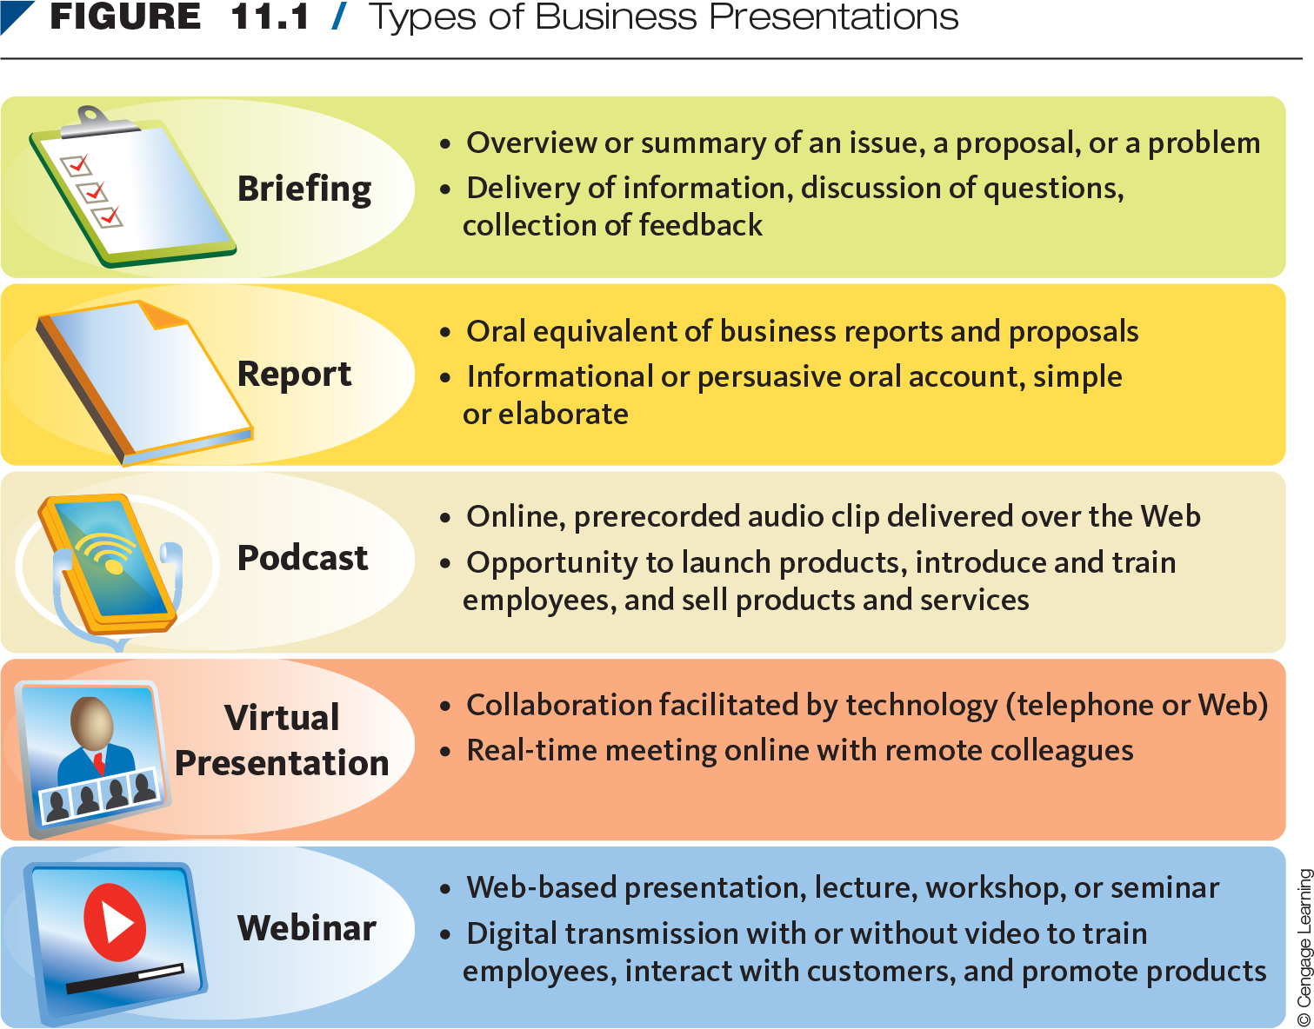
Types of Business Presentations
Notes:
Discuss the types of presentations.

Slide 6
Preparing for a Presentation
What’s my purpose?
  Sell
  Persuade
  Inform
Who’s my audience?
  Friendly
  Neutral
  Uninterested
  Hostile
Notes:
What do you want your listeners to remember or do?
Ask, “How will this topic appeal to my audience?”

Slide 7
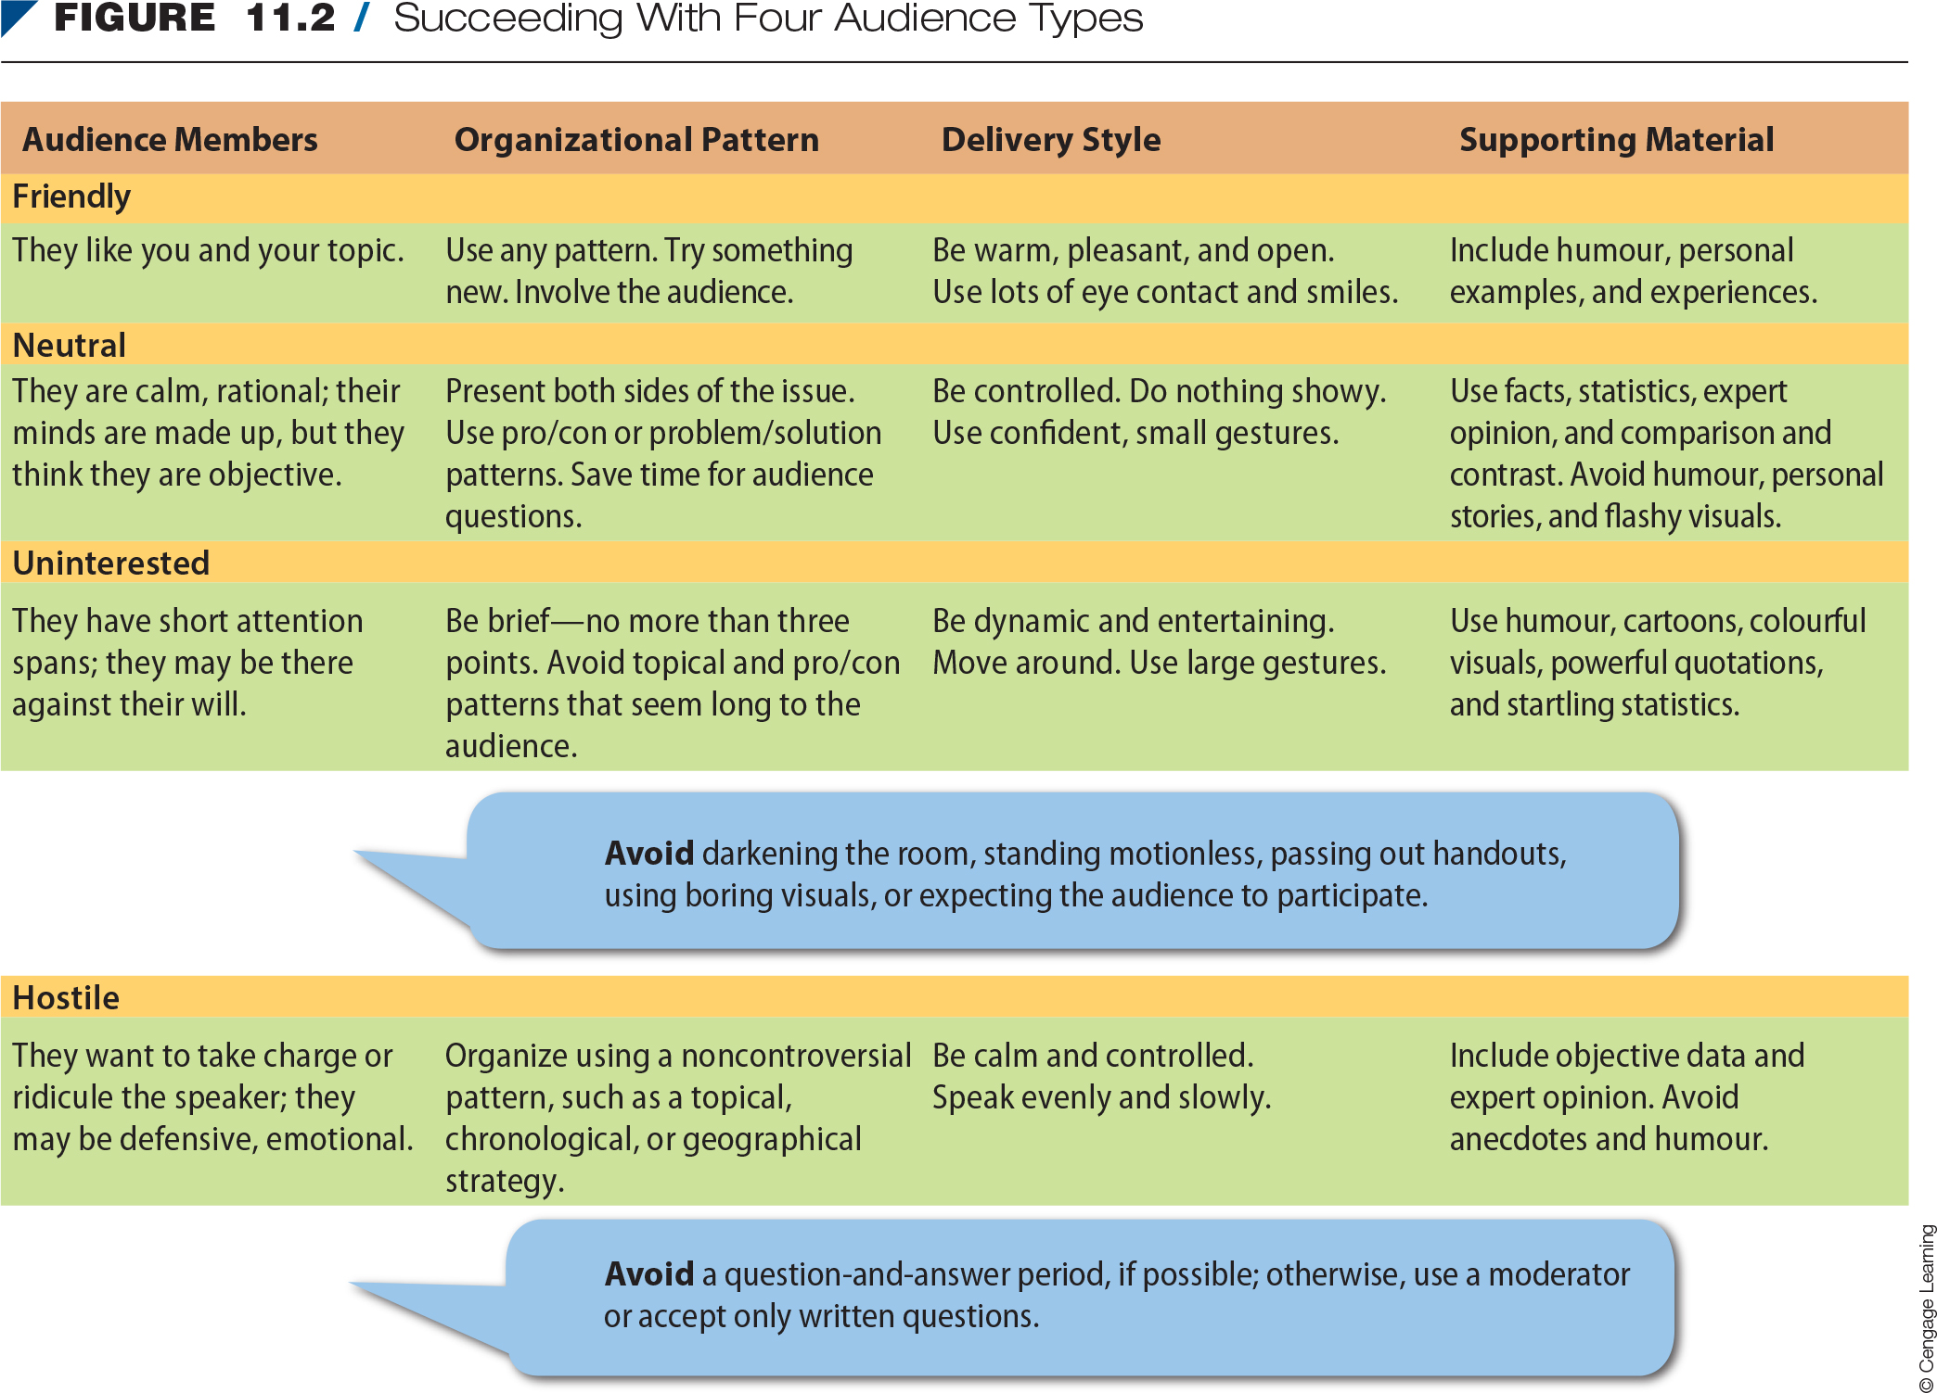
Succeeding With
Four Audience Types

Slide 8
Organizing Presentations for
Impact and Rapport
Opening: introduce yourself and tell the audience what you’re going to say.
Body: explain your points persuasively by using visual aids, some humour, and appropriate audience proximity, and by going off-slide a couple of times.
Pleasant closing: remind the audience of your main points and look forward to future interactions.
Notes:
Good organization and conscious repetition are the two most powerful keys to audience comprehension and retention.

Slide 9
Capture Attention in the Introduction
Capture listeners’ attention and get them involved.
Identify yourself and establish your credibility.
Preview your main points.

Slide 10
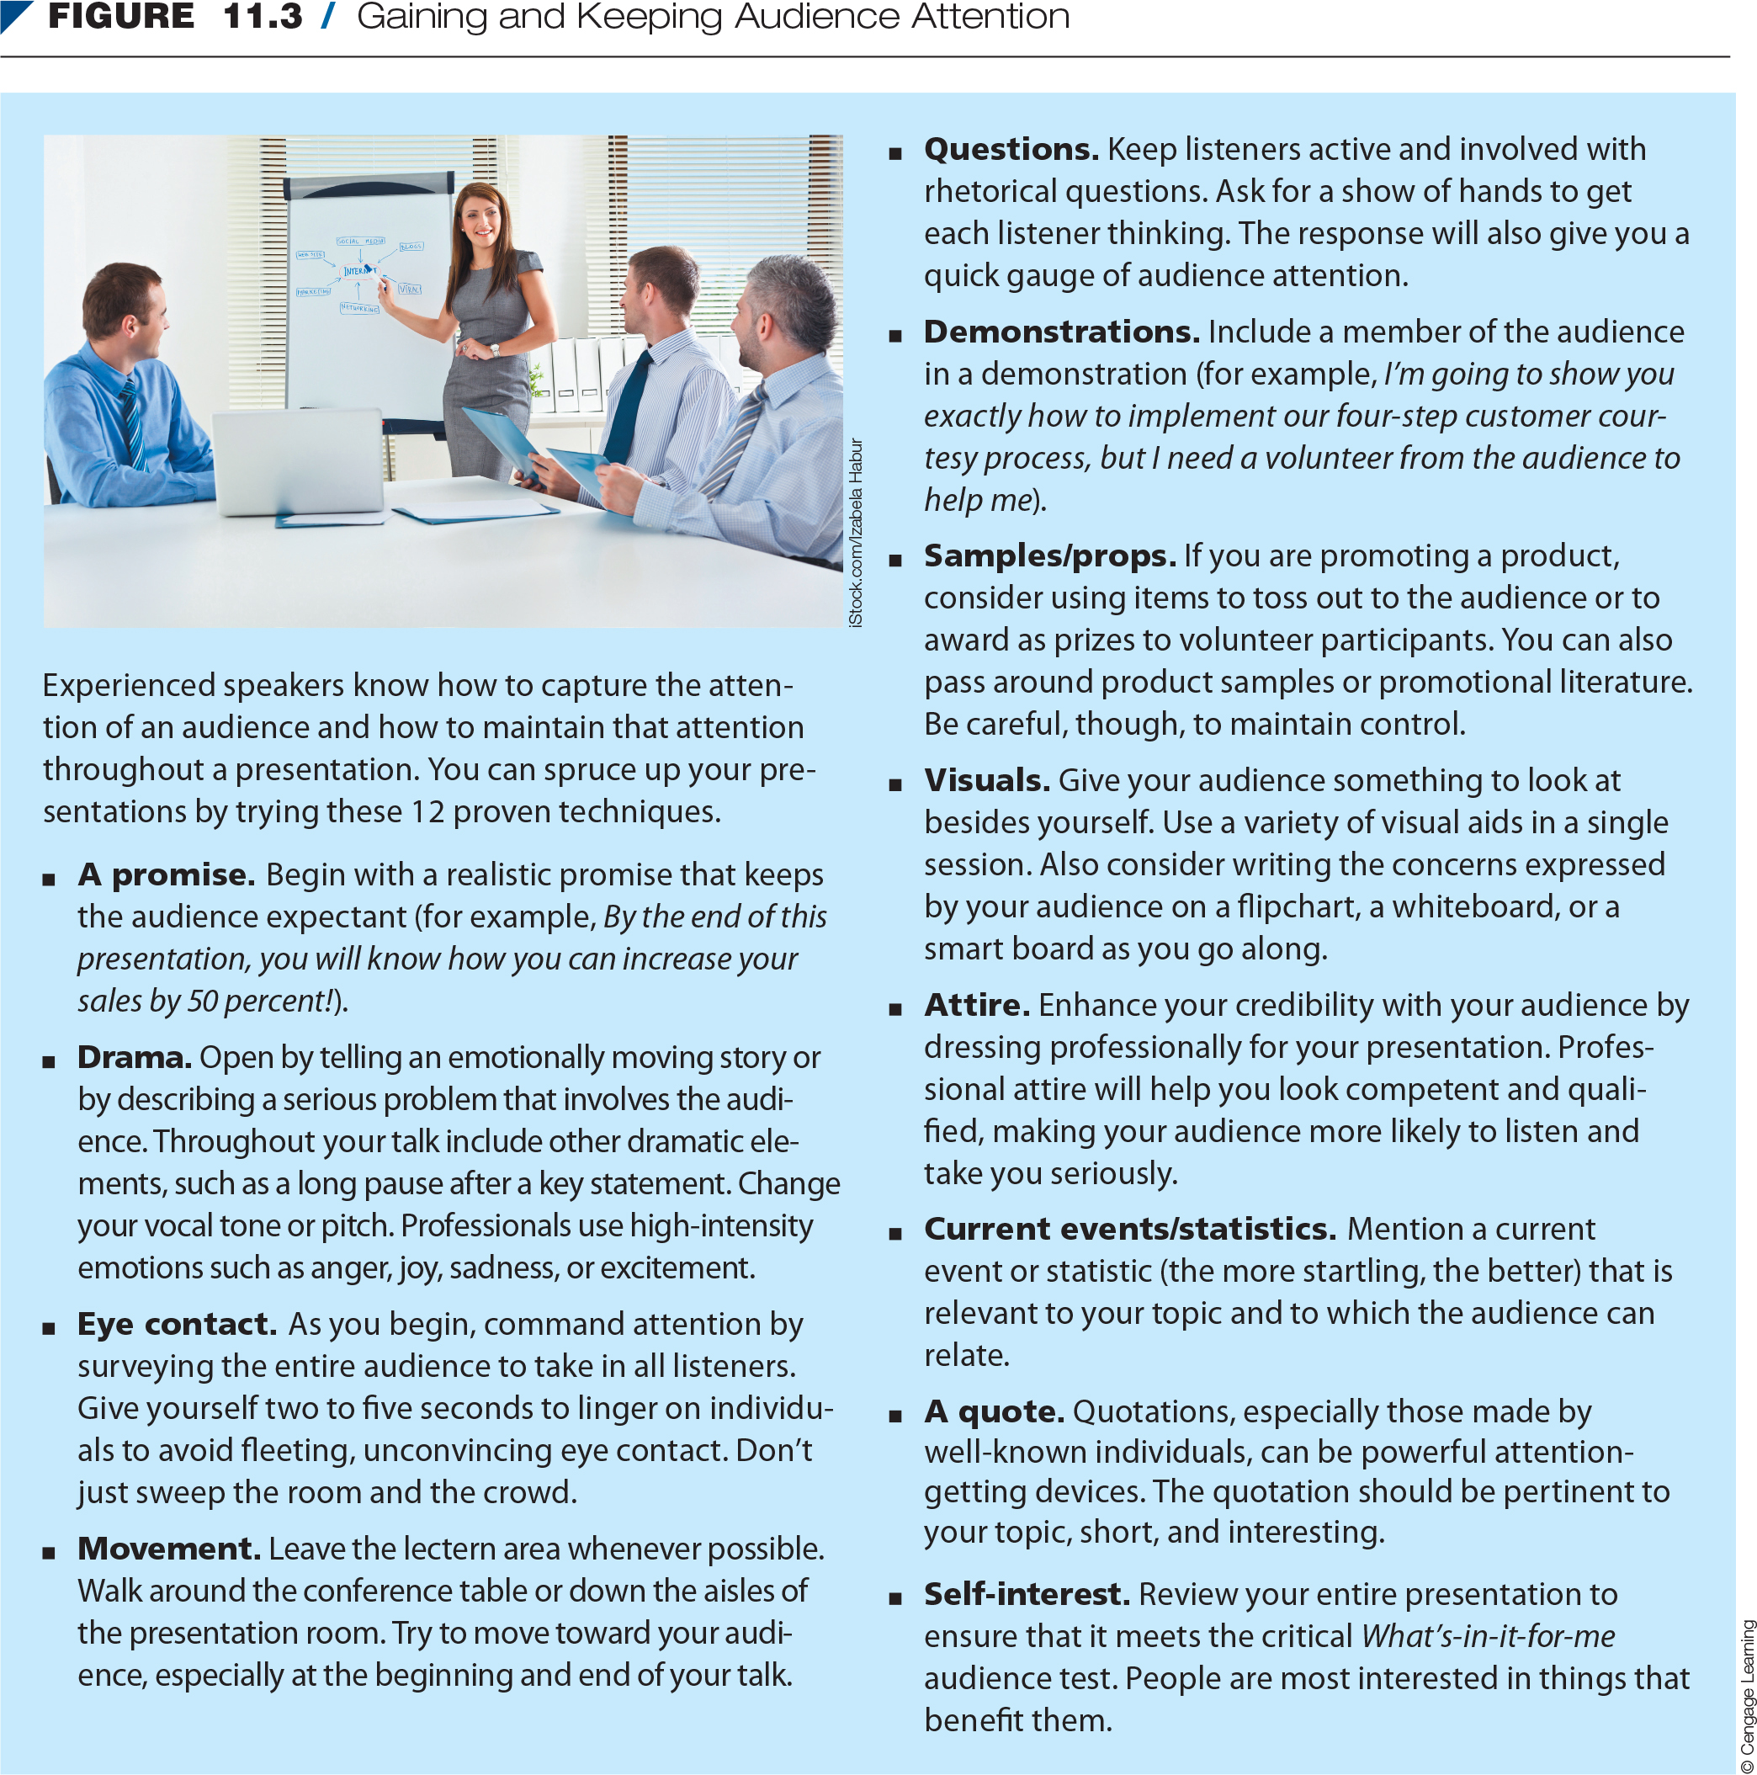
Gaining and Keeping
Audience Attention

Slide 11
Explain Persuasively in the
Body of the Presentation
Limit the number of main points.
Develop each main point with adequate, but not excessive, explanation and details.
Create a presentation outline to organize and sequence the main ideas.
Select a pattern to organize your presentation.

Slide 12
Explain Persuasively in the
Body of the Presentation (cont’d)
Organization patterns:
Chronology
Geography/space
Topic/function/
conventional grouping
Comparison/contrast (pro/con)
Journalism pattern
Value/size
Importance
Problem/solution
Simple/complex
Best case/worst case

Slide 13
Summarize in the Conclusion
Summarize the main ideas or points of the presentation.
Leave the audience with a specific/memorable takeaway.
Include a friendly statement as you leave the presentation area.

Slide 14
Build Audience Rapport
Effective imagery: use analogies, metaphors, similes, personal anecdotes, and so on, instead of dry facts.
Verbal signposts: preview, switch directions, and summarize.
Nonverbal messages: look professional, animate your body, punctuate your words, get out from behind the lectern, table, or desk, and vary your facial expression.

Slide 15
Types of Visual Aids
Slides
Infographics
Flipchart/whiteboard/blackboard/
smartboard
Handouts and props

Slide 16
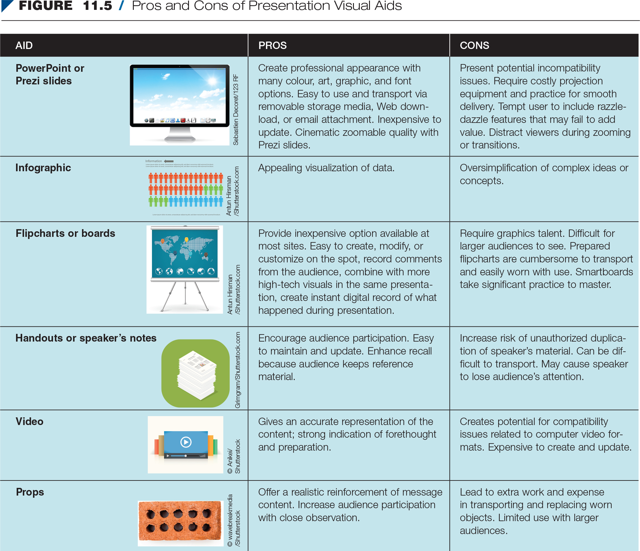
Pros and Cons of Presentation
Visual Aids
Notes:
Go through the slide with students.

Slide 17
Designing Effective Presentations
Analyze the situation and purpose.
Anticipate your audience.
Consider slide colour and organization.
Design your visuals.

Slide 18
Designing Effective Presentations (cont’d)
Revise, proofread, and evaluate your slides.
Use slides effectively in front of an audience.
  Practise and prepare.
  Keep your audience engaged.
Notes:
See page 318 to discuss with students the criteria for creating slides. A slide should be created only if it accomplishes one of the following purposes: generates interest in what you’re saying and helps the audience follow your ideas, highlights points you want your audience to remember, introduces or reviews your key points, provides a transition from one major point to the next, or illustrates and simplifies complex ideas.

Slide 19
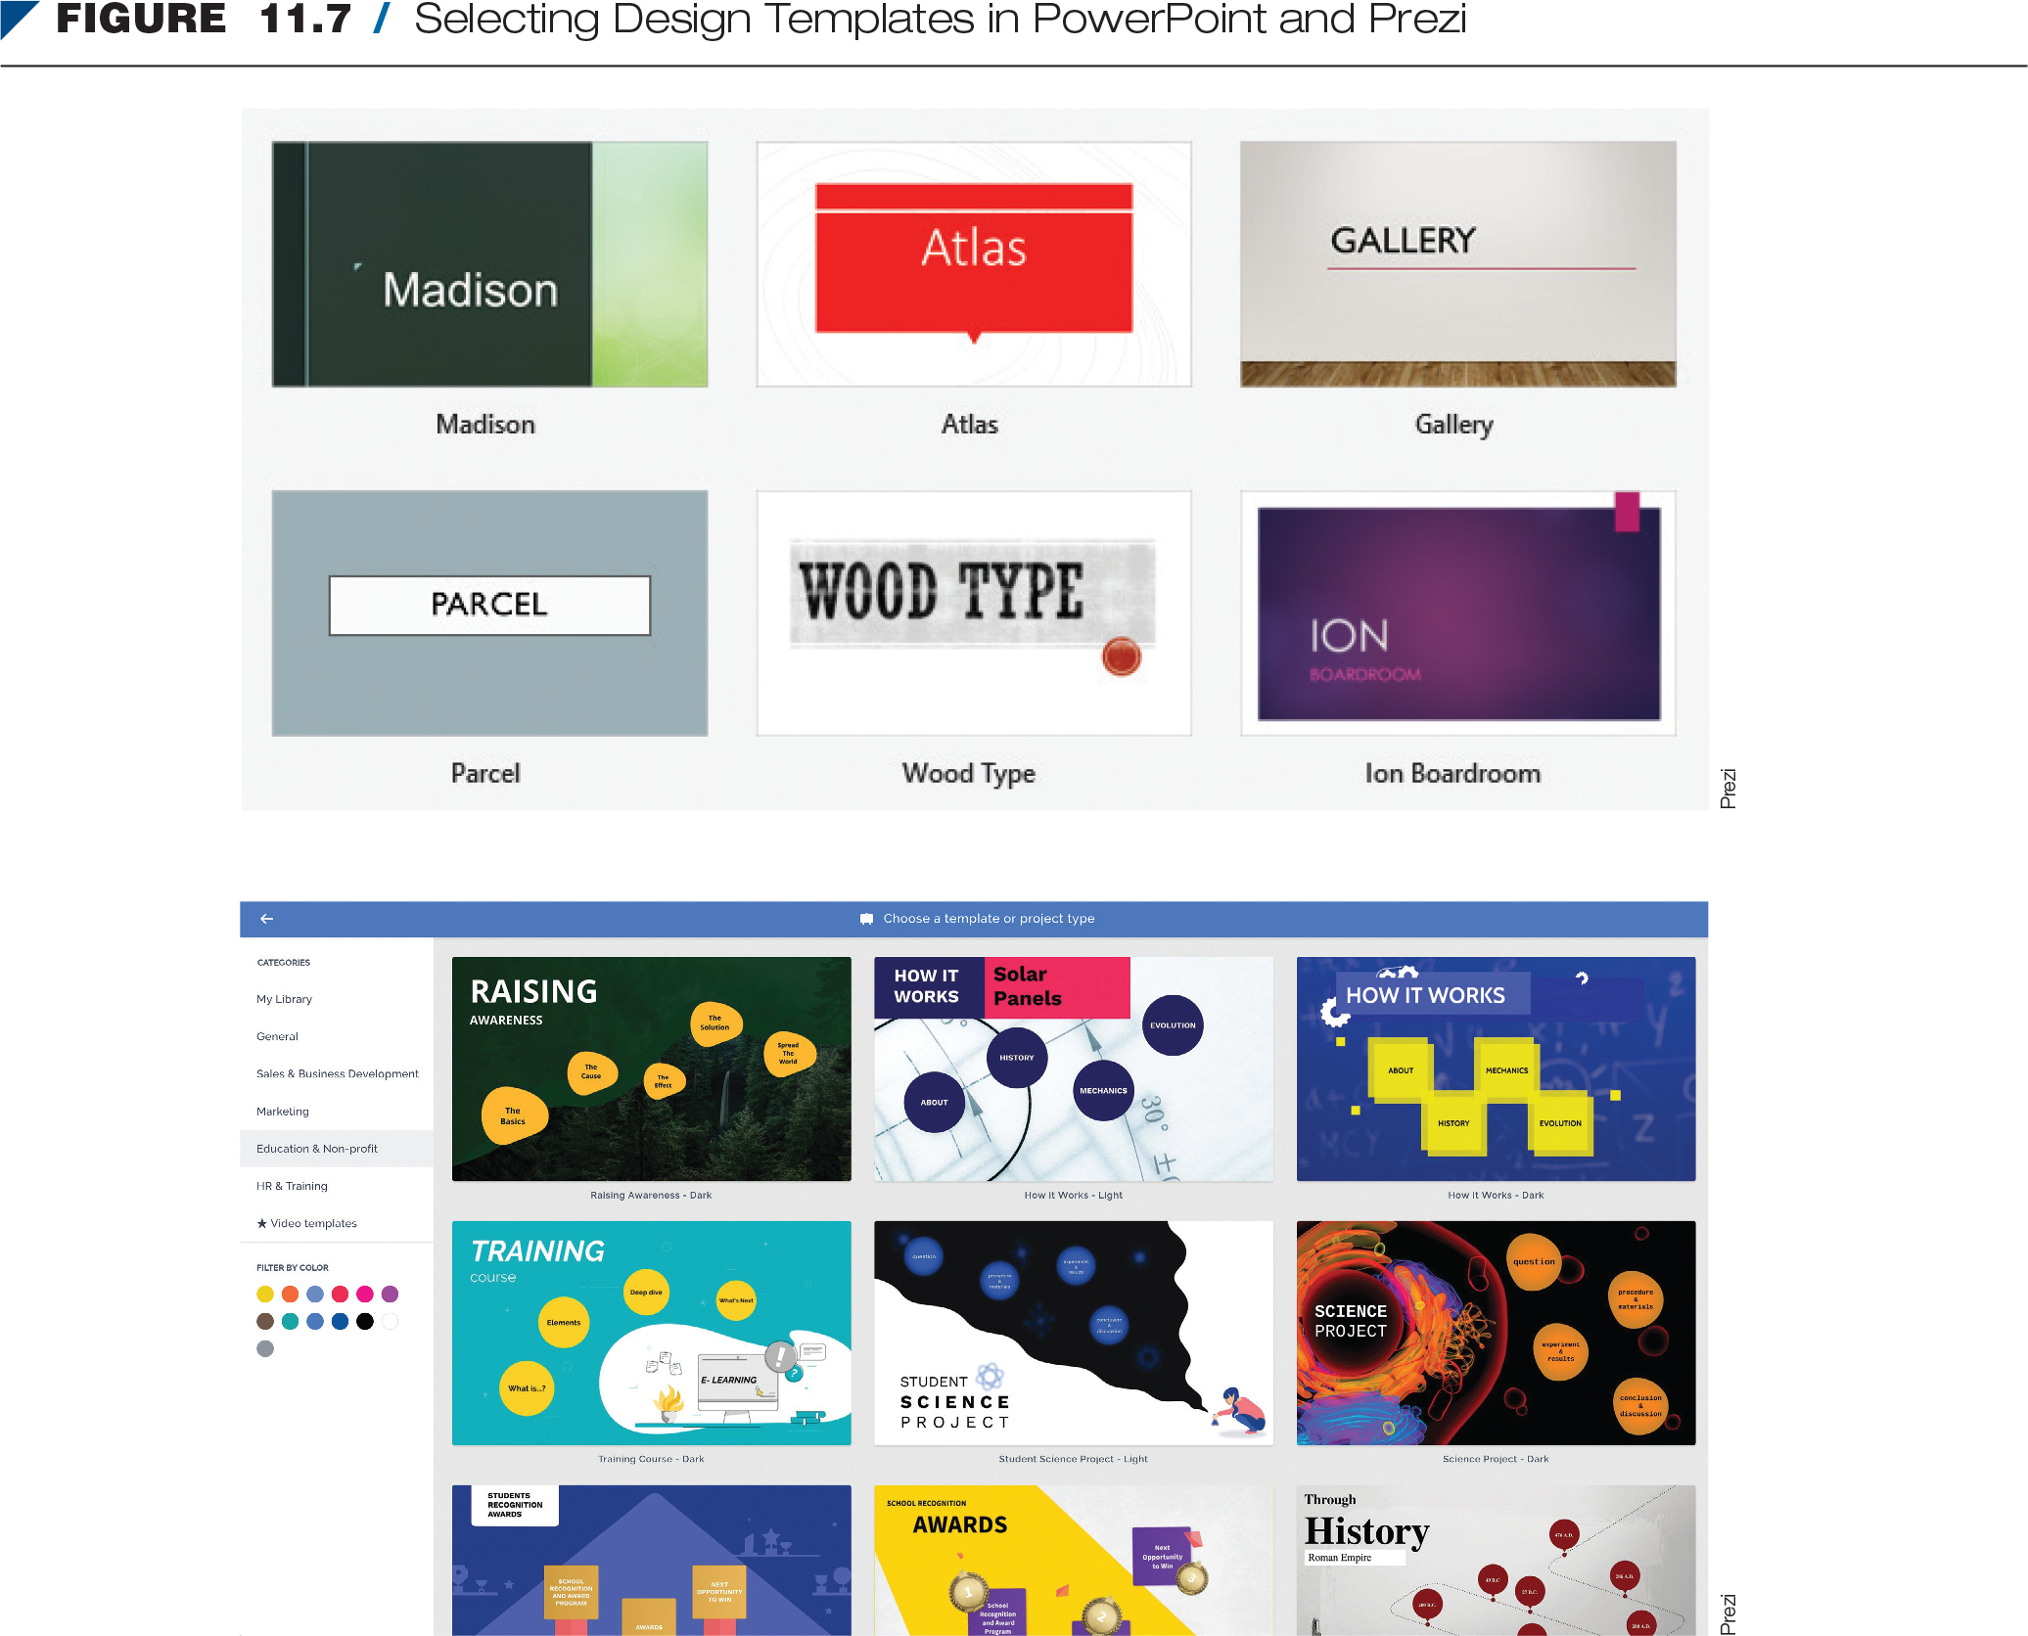
Selecting Design Templates in PowerPoint and Prezi

Slide 20
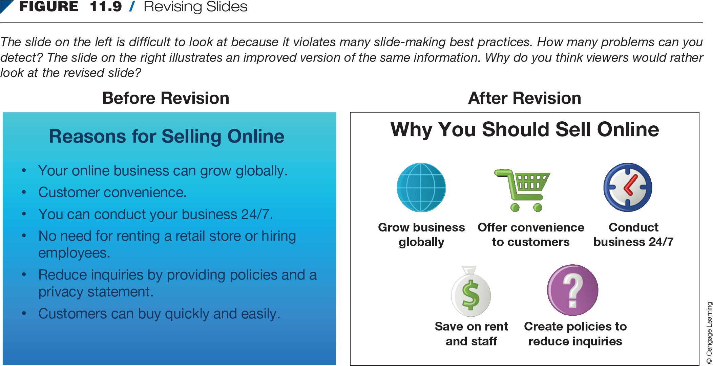
Revising Slides
Notes:
Go through Figure 11.9 on page 318 with students.

Slide 21
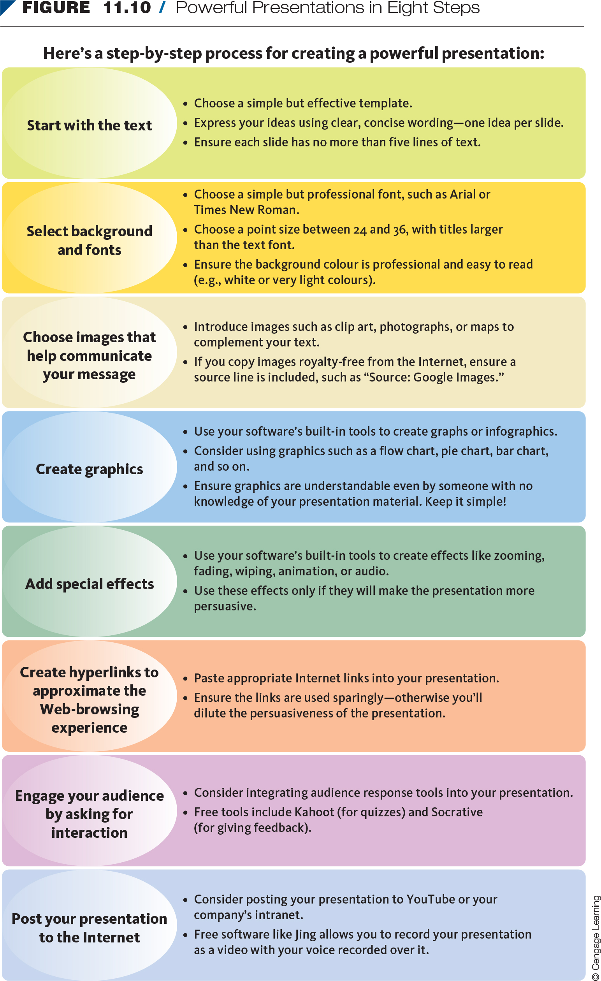
Powerful Presentations in Eight Steps

Slide 22
Polishing Your Delivery
Delivery method
  Use cue cards to keep you on track and prompt your memory.
Delivery techniques
  Focus on preparation, organization, visual aids, and delivery.

Slide 23
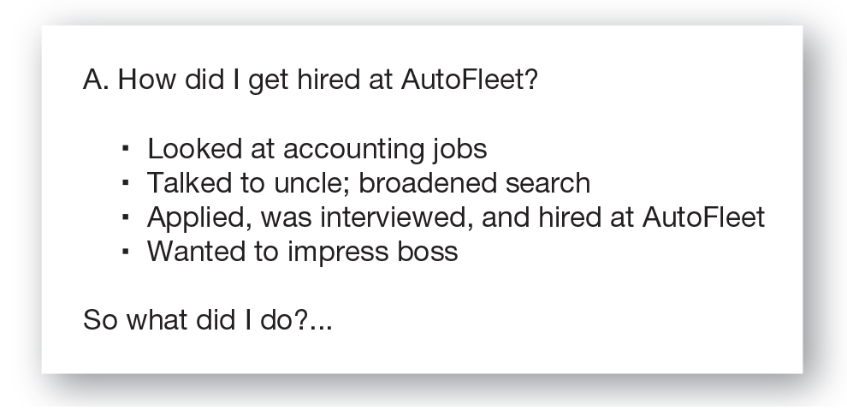
Sample Cue Card for Presentation

Slide 24
Delivery Techniques
Before your presentation:
  Prepare thoroughly.
  Rehearse repeatedly.
  Time yourself.
  Request a lectern.
Check the room.
Greet members of the audience.
Practise stress reduction.
Notes:
See Figure 11.12: How to Conquer Stage Fright on page 322. Discuss with students.

Slide 25
Delivery Techniques
During your presentation:
  Begin with a pause.
  Present your first few sentences from memory.
  Maintain eye contact.
  Control your voice and vocabulary.
  Put the brakes on.
Move naturally.
Use visual aids effectively.
Avoid digressions.
Summarize your main points.

Slide 26
Delivery Techniques
After your presentation:
  Distribute handouts.
  Encourage questions.
  Repeat questions.
  Reinforce your main points.
Keep control.
Avoid “Yes, but” answers.
End with a summary and appreciation.

Slide 27
Summary
Differentiate between major presentation types.
Organize the presentation effectively and build audience rapport.
Use presentation aids.
Design effective visual presentations.
Deploy effective presentation delivery techniques.

