Slide 1

The Reflective Analyst
Developing Skills to Meet the Evolving Tech Landscape

Slide 2

In the ever-shifting terrain of the technology and business analysis sector, the need for self-assessment and continuous personal development is paramount. To align with industry demands, professionals must regularly introspect, gauge their competencies, and chart paths for improvement.
This presentation guides your through techniques and strategies to assess personal skills, offering guidance on fostering growth in the tech realm.

Slide 3
Technique 1:
Self Assessment
For example…
A Business Analyst might discover through the MBTI that they are an INTJ, implying a logical, structured approach to problem-solving.
This insight can be further nuanced by exploring resources like the International Institute of Business Analysis (IIBA), which details the competencies expected of Business Analysts, allowing for a comprehensive skill gap analysis.
The Foundation of Personal Growth
Initiating the journey of self-improvement begins with understanding one's current skill set.
Comprehensive self-assessment tools, such as the Myers-Briggs Type Indicator (MBTI), are designed to help individuals understand their inherent strengths and tendencies. While these tools offer broad insights, tailoring them to the tech and business analysis sphere involves juxtaposing their results with industry-specific competencies.

Slide 4
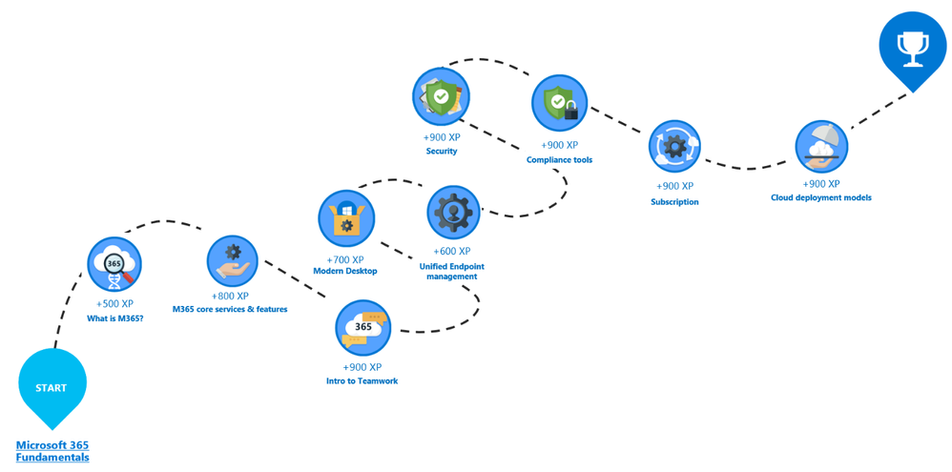
Technique 2:
Embracing Feedback
The Mirror to Our Blind Spots
While self-reflection is valuable, external feedback provides a more holistic perspective.
Seeking feedback from peers, supervisors, or mentors can uncover areas of improvement often overlooked in self-assessment.
Companies like Microsoft encourage a culture of continuous feedback, recognizing it as the bedrock of personal and professional development.
Microsoft's Learning Paths offer a structured approach, where feedback is integral to understanding one's standing concerning industry standards.
4

Slide 5

Technique 3:
Industry Benchmarks
The Foundation of Personal Growth
Staying updated with industry benchmarks is a proactive approach to skill assessment.
Certifications and courses, such as those provided by Coursera or edX, can serve as benchmarks. For instance, a Data Analyst might pursue a certification in Python programming. Upon completion, not only does the analyst acquire a skill, but they also have a tangible metric to gauge their proficiency against industry standards.
EXPLORE:
Top 10 edX Alternatives & Competitors

Slide 6

Technique 4:
Mapping Job to Roles
The Litmus Test of Relevance
Another effective strategy is to periodically review job listings in one's desired role or career progression path.
Websites like LinkedIn or Glassdoor can offer insights into the skills currently in demand. For example, an IT Analyst eyeing a shift towards Systems Analysis might discover the rising demand for proficiency in cloud integration tools. This revelation can guide targeted skill acquisition, ensuring relevance in the job market.

Slide 7

Technique 5:
Creating a PDP
Personal Development Plan (PDP):
Charting the Course Forward
With insights from self-assessments, feedback, and industry benchmarks, the next step is to create a structured Personal Development Plan (PDP).
Platforms like MindTools offer resources to draft effective PDPs. For our aspiring Systems Analyst, this could mean allocating time to learn about Amazon Web Services, setting milestones, and regularly revisiting the plan to accommodate new industry trends.

Slide 8

Technique 6:
Continuous Learning
The Lifelong Commitment
The tech industry, by its inherent nature, is in perpetual flux.
Committing to lifelong learning is not just an asset but a necessity.
Several websites offer courses on a wide variety of topics (Udemy, Khan Academy, LinkedIn Learning, etc.). Subscribing to tech magazines, journals, or attending webinars can also ensure one stays current on the latest developments.
8

Slide 9

Final Thoughts
In the vast expanse of the technology and business analysis field, personal growth is both a journey and a destination. Through diligent self-assessment, continuous learning, and an unwavering commitment to improvement, professionals can ensure they not only meet but exceed the evolving demands of the industry.
As you harness these strategies, remember that every step forward, no matter how small, is progress in this grand odyssey of professional development.

