Slide 1
Databases
[ll
[ll
[ll
[ll
[ll
Professor: Nathan Abourbih

Slide 2
Joins
A join lets you combine columns from two or more tables into a single result set.
The explicit syntax for an inner join:
SELECT
select_list FROM
table_1
JOIN table_2
ON join_condition_1 JOIN table_3
ON join_condition_2...

Slide 3
Joins
A join combines columns from two or more tables into a result set based on the join conditions you specify. For an inner join, only those rows that satisfy the join condition are included in the result set.
A join condition names a column in each of the two tables involved in the join and indicates how the two columns should be compared.
Tables are typically joined on the relationship between the primary key in one table and a foreign key in the other table.
If the two columns in a join condition have the same name, you must qualify them with the table name so MySQL can distinguish between them.
To code a qualified column name, type the table name, followed by a period, followed by the column name.

Slide 4
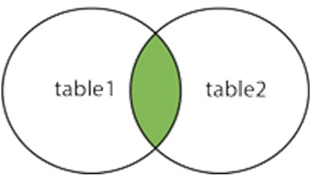
INNER JOIN Syntax
To start, we will review how to code the most common type of join, an inner join.
The following shows the explicit syntax for inner joins.
https://www.w3schools.com/sql/sql_join.asp

Slide 5
INNER Join Example - Tables
https://www.w3schools.com/sql/sql_join.asp

Slide 6
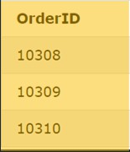
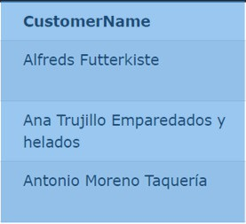
Inner Join Example
It is good form to qualify columns with their table name. This is optional unless multiple tables contain a column with the
same name, in which case it is required.
+
https://www.w3schools.com/sql/sql_join.asp

Slide 7
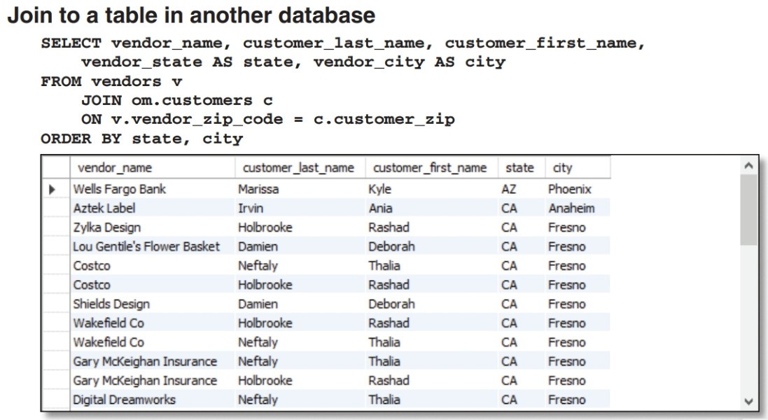
Join Another Database
Occasionally need to join to a table that’s in another database.
To do that, you must qualify the table name in the other database by prefixing the table name with the database name.
A SQL server can store tables in multiple databases. These databases are sometimes referred to as schemas

Slide 8
Table Aliases
The syntax for an inner join that uses table aliases:
SELECT
select_list FROM
table_1
JOIN table_2 as first_table ON join_condition_1
JOIN table_3 as second_table ON join_condition_2...

Slide 9
An inner join with aliases for all tables

SELECT invoice_number, vendor_name, invoice_due_date,
invoice_total - payment_total - credit_total
AS balance_due
FROM vendors v JOIN invoices i
ON v.vendor_id = i.vendor_id
WHERE invoice_total - payment_total - credit_total > 0
ORDER BY invoice_due_date DESC

Slide 10
TRY IT YOURSELF
MYSQL - RETRIEVE DATA FROM MULTIPLE TABLES
Using the ap database, write a query to satisfy the following requirements:

Slide 11
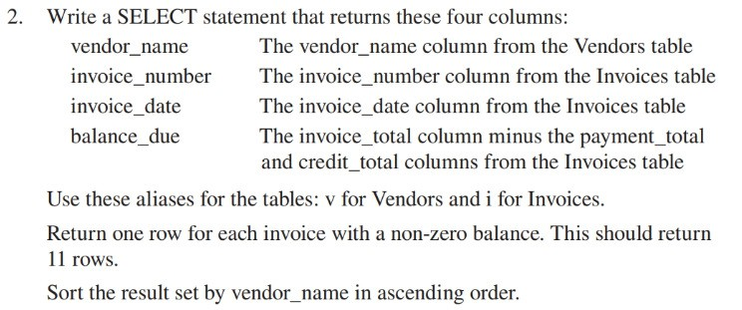
TRY IT YOURSELF
MYSQL - RETRIEVE DATA FROM MULTIPLE TABLES
Using the ap database, write a query to satisfy the following requirements:

Slide 12
A statement that joins four tables

SELECT vendor_name, invoice_number, invoice_date,
line_item_amount, account_description
FROM vendors v
JOIN invoices i
ON v.vendor_id = i.vendor_id
JOIN invoice_line_items li
ON i.invoice_id = li.invoice_id
JOIN general_ledger_accounts gl
ON li.account_number = gl.account_number
WHERE invoice_total - payment_total - credit_total > 0 ORDER BY vendor_name, line_item_amount DESC
M©u2r0a1c5h,'sMMikyeSMQuLr,aCc4h & Associates, Inc.
Slide 12
(11 rows)

Slide 13
Multiple Join Conditions
Although a join condition typically consists of a single comparison, you can include two or more comparisons in a join condition using the AND and OR operators.
An inner join with two conditions

SELECT customer_first_name, customer_last_name
FROM customers c JOIN employees e
ON c.customer_first_name = e.first_name
AND c.customer_last_name = e.last_name
(1 row)

Slide 14
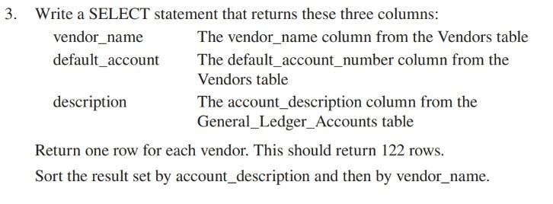
TRY IT YOURSELF
MYSQL - RETRIEVE DATA FROM MULTIPLE TABLES
Using the ap database, write a query to satisfy the following requirements:

Slide 15
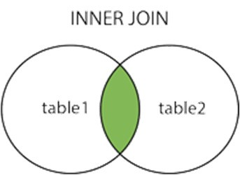
INNER JOIN Syntax
To start, we will review how to code the most common type of join, an inner join.
The following shows the explicit syntax for inner joins.
https://www.w3schools.com/sql/sql_join.asp

Slide 16
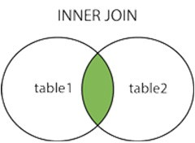
INNER Join Example
It is good form to qualify columns with their table name. This is optional unless multiple tables contain a column with the
same name, in which case it is required.
+
https://www.w3schools.com/sql/sql_join.asp

Slide 17
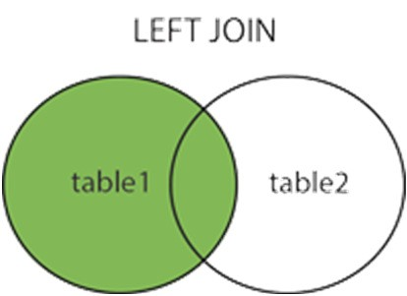
LEFT OUTER JOIN Syntax
The following shows the explicit syntax for outer joins.
You can use outer joins to join multiple tables.
You can combine inner and outer joins within a single SELECT statement
https://www.w3schools.com/sql/sql_join.asp

Slide 18
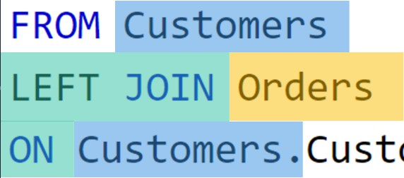
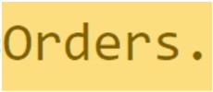
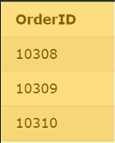
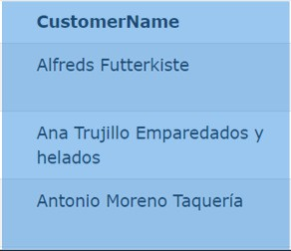
LEFT OUTER Join Example
https://www.w3schools.com/sql/sql_join.asp

Slide 19
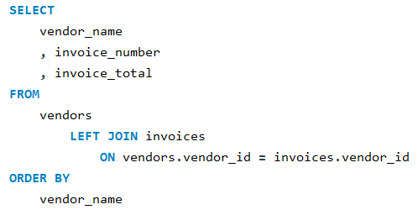
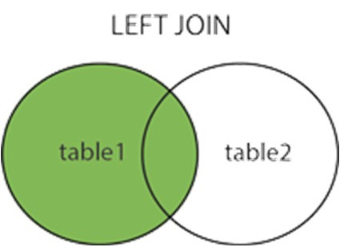
A left outer join

(202 rows)

Slide 20
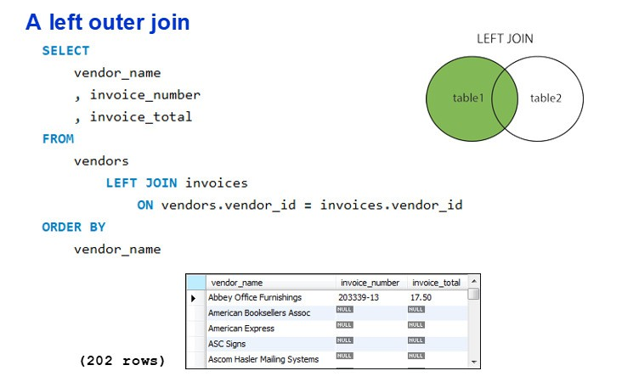
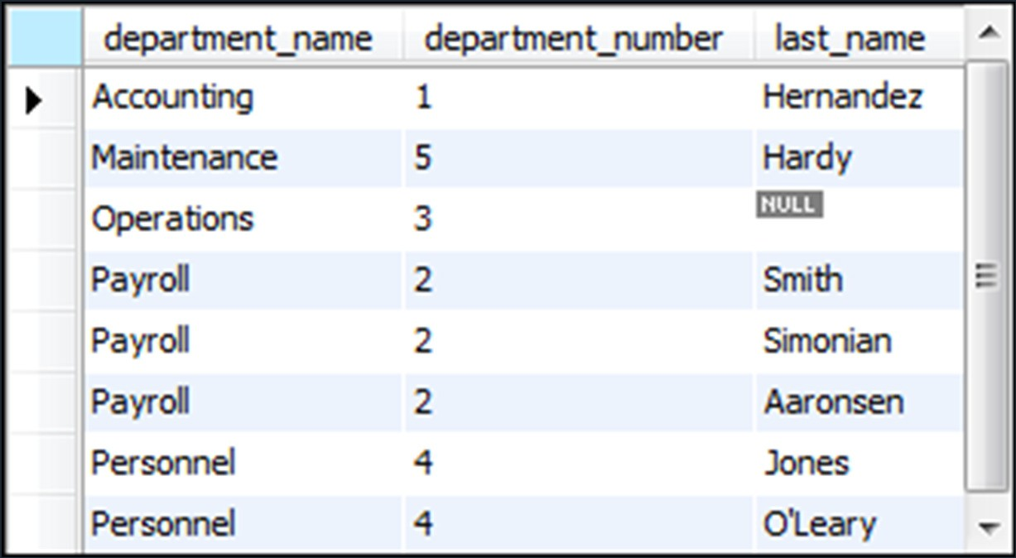
TRY IT YOURSELF
MYSQL - RETRIEVE DATA FROM MULTIPLE TABLES
Using the EX database, write a query to output the following using a LEFT join:

Slide 21
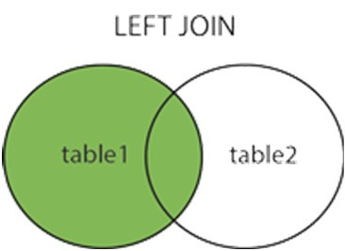
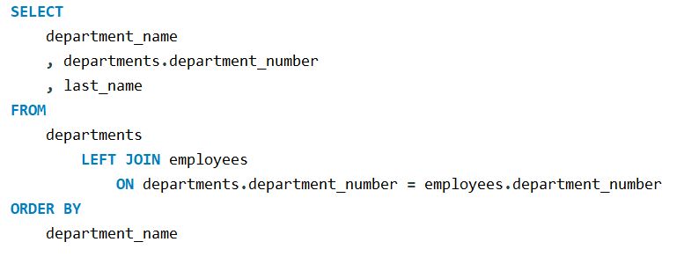
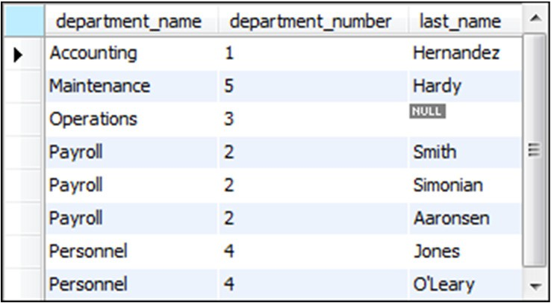
A left outer join
(Database: EX)

(8 rows)

Slide 22
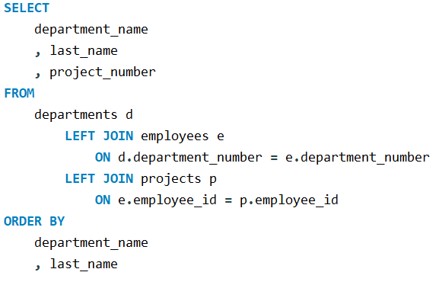
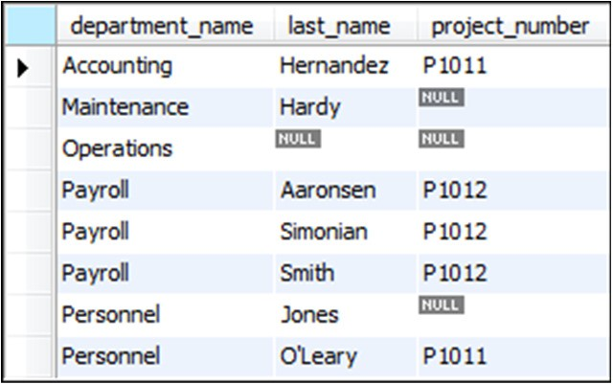
Join three tables using left outer joins
(Database: EX)

(8 rows)

Slide 23
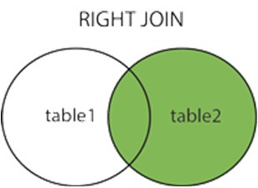
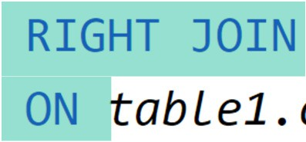
RIGHT OUTER JOIN Syntax
The following shows the explicit syntax for outer joins.
https://www.w3schools.com/sql/sql_join.asp

Slide 24
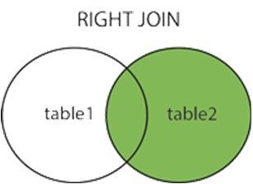
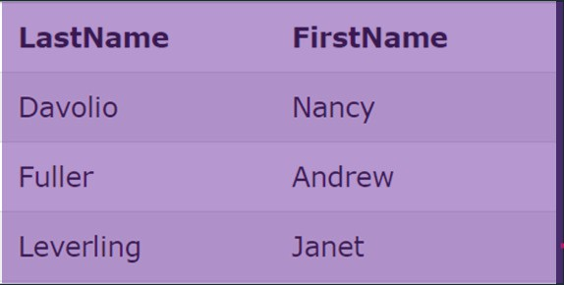
RIGHT OUTER Join Example
null
https://www.w3schools.com/sql/sql_join.asp

Slide 25
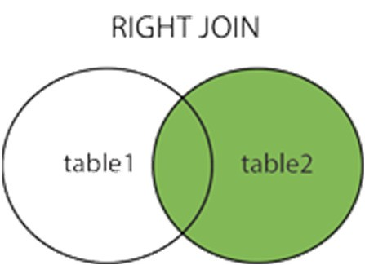
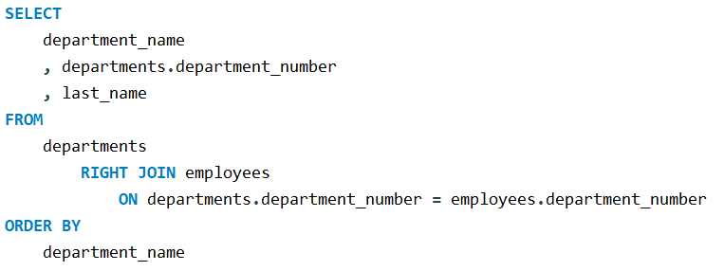
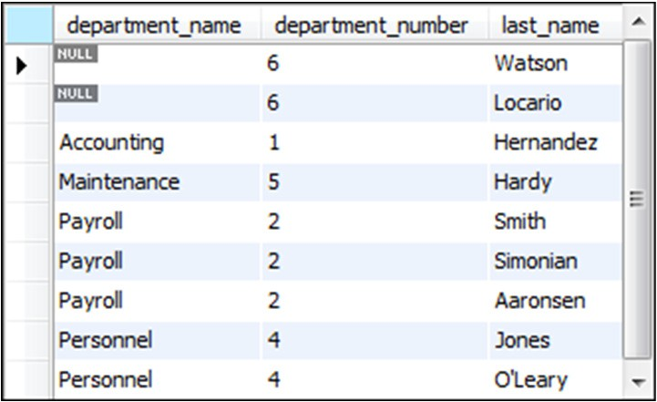
A right outer join
Database: EX


Slide 26
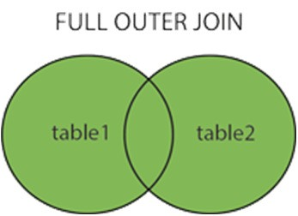
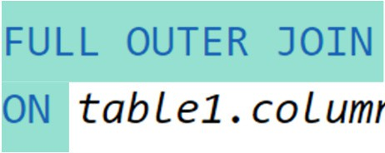
FULL OUTER JOIN Syntax
The following shows the explicit syntax for outer joins.
https://www.w3schools.com/sql/sql_join.asp

Slide 27
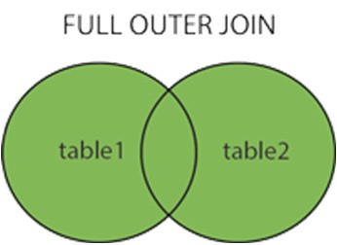
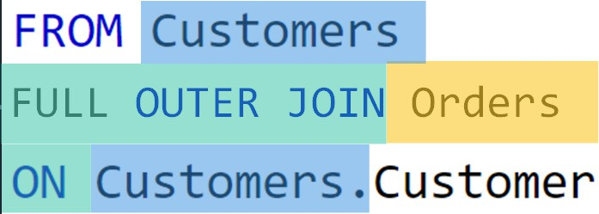
FULL OUTER Join Example
FULL OUTER JOIN Orders
https://www.w3schools.com/sql/sql_join.asp

Slide 28
Implicit Syntax
Although it’s generally considered a best practice to use the explicit inner join syntax described earlier, SQL also provides the implicit inner join syntax.
When you use the implicit syntax for an inner join, you code the tables in the FROM clause separated by commas.
SELECT
select_list FROM
table_1, table_2 [, table_3]...
WHERE
table_1.column_name = table_2.column_name …

Slide 29
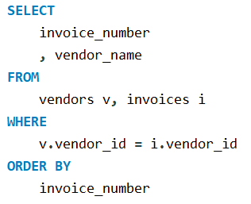
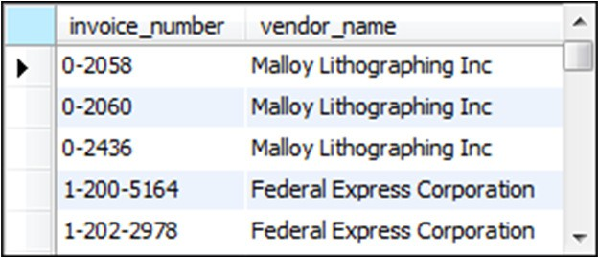
The implicit syntax for an inner join
SELECT select_list

FROM table_1, table_2 [, table_3]...
WHERE table_1.column_name operator table_2.column_name
[AND table_2.column_name operator table_3.column_name]...
Join the Vendors and Invoices tables
Database: AP

Slide 30
Equijoin / Using
When you use the equal operator to join two tables on a common column, the join can be referred to as an equijoin (or an equi-join).
When you code an equijoin, it’s common for the columns that are being
compared to have the same name.
For joins like these, you can simplify the query with the USING keyword. To do that, you code a USING clause instead of an ON clause to specify the join.
You can use the USING keyword to simplify the syntax for joining tables.
The join can be an inner join or an outer join.
The tables must be joined by a column that has the same name in both tables.
To include multiple columns, separate them with commas.
The join must be an equijoin, which means that the equals operator is used to compare the two columns.

Slide 31
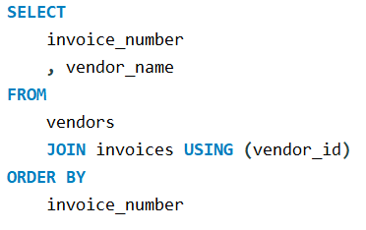
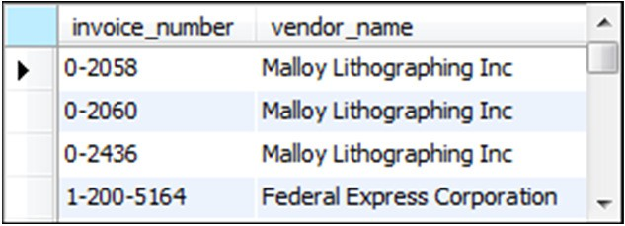
The syntax for a join that uses the USING keyword
SELECT select_list FROM table_1

[{LEFT|RIGHT} [OUTER]] JOIN table_2
USING (join_column_1[, join_column_2]...)
[[{LEFT|RIGHT} [OUTER]] JOIN table_3
USING (join_column_1[, join_column_2]...)]...
Use the USING keyword to join two tables
Database: AP
M© u2r0a1c5h,'sMMikyeSMQuLr,aCc4h & Associates, Inc.
Slide 31

Slide 32
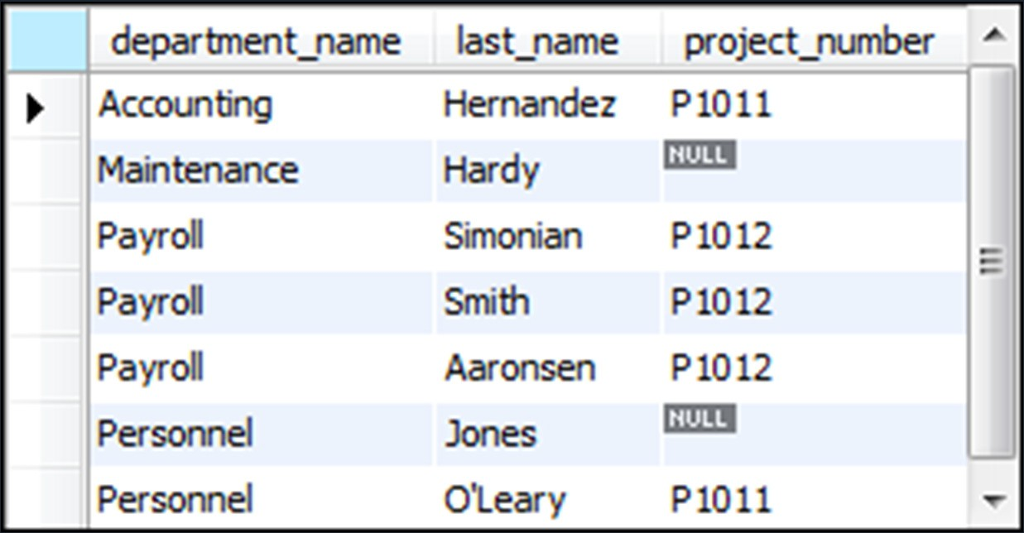
TRY IT YOURSELF
MYSQL - RETRIEVE DATA FROM MULTIPLE TABLES
Using the EX database, write a query to output the following using the
USING syntax and a LEFT join:

Slide 33
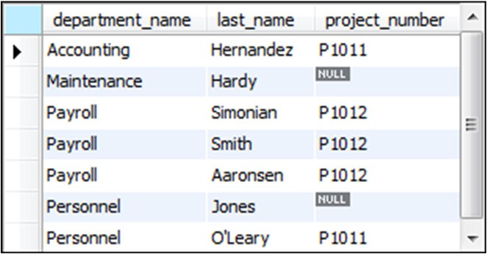
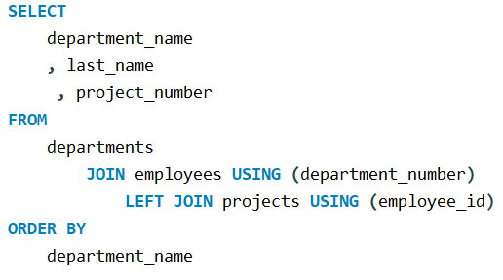
Use the USING keyword to join three tables
Database: EX

M© u2r0a1c5h,'sMMikyeSMQuLr,aCc4h & Associates, Inc.
Slide 33

Slide 34
Natural Join
When you code a natural join, you don’t specify the column that’s used to join the two tables.
Instead, the database automatically joins the two tables based on all columns in
the two tables that have the same name.
As a result, this type of join only works correctly if the database is designed in a certain way.
You can use the NATURAL keyword to create a natural join that joins two tables based on all columns in the two tables that have the same name.
Although the code for a natural join is shorter than the code for joins that use the ON or USING clause, a natural join only works correctly for certain types of database structures.
In addition, a natural join often yields unexpected results for complex queries. As a result, it’s more common to use the ON or USING clause to join tables.

Slide 35
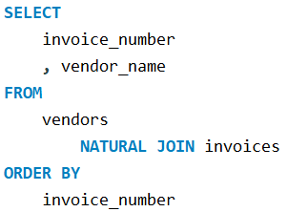
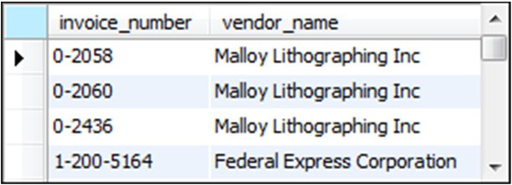
The syntax for a join
that uses the NATURAL keyword

SELECT select_list FROM table_1
NATURAL JOIN table_2
[NATURAL JOIN table_3]...
Use the NATURAL keyword to join tables
Database: AP
M© u2r0a1c5h,'sMMikyeSMQuLr,aCc4h & Associates, Inc.
Slide 35

Slide 36
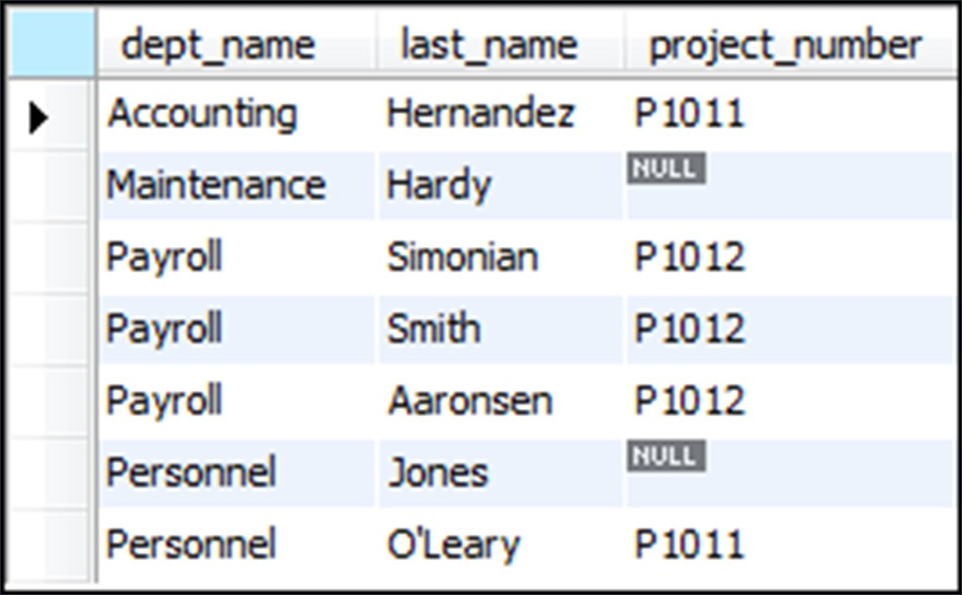
TRY IT YOURSELF
MYSQL - RETRIEVE DATA FROM MULTIPLE TABLES
Using the EX database, write a query to output the following using the NATURAL Syntax and a LEFT join:

Slide 37
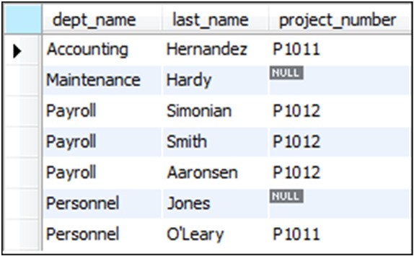
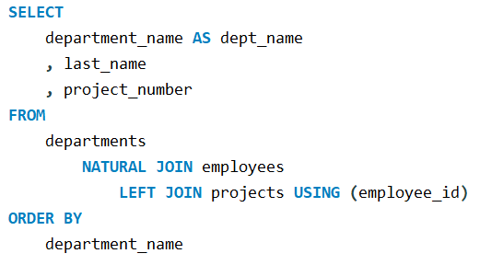
Use the NATURAL keyword in a statement that joins three tables

Database: EX
M© u2r0a1c5h,'sMMikyeSMQuLr,aCc4h & Associates, Inc.
Slide 37

Slide 38
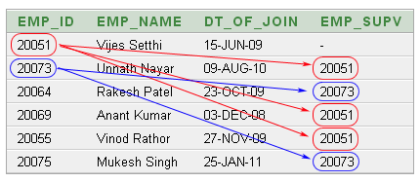
Self Join
A self-join is a join that joins a table with itself.
When you code a self-join, you must use aliases for the tables, and you must qualify each column name with the alias.
https://www.w3resource.com/sql/joins/perform-a-self-join.php

Slide 39
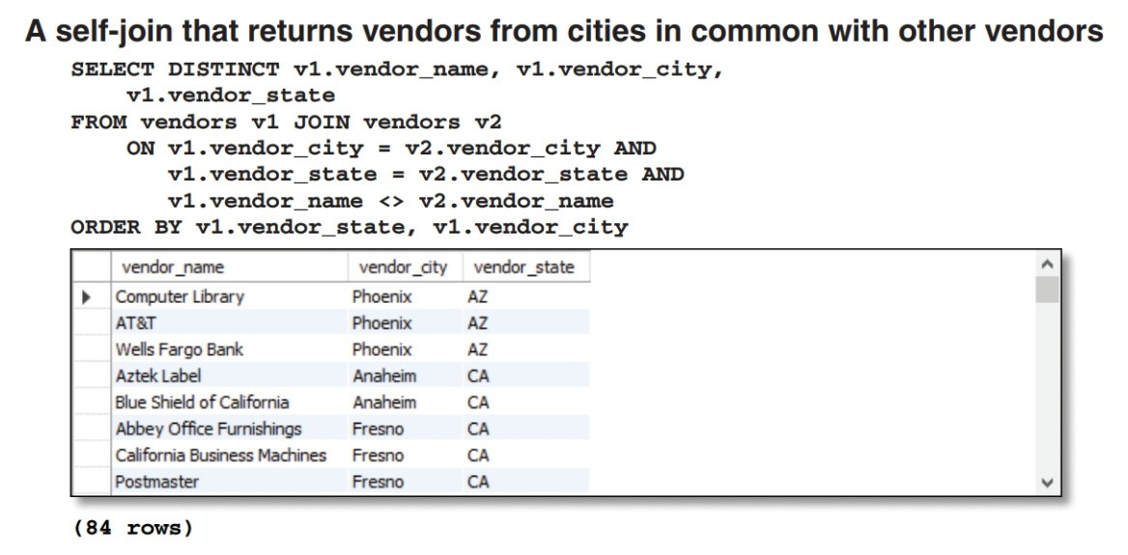
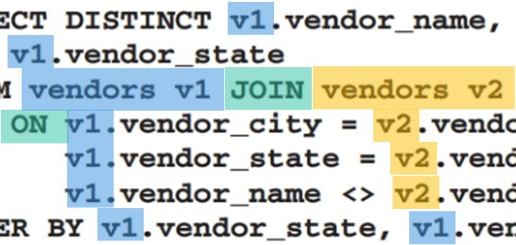


Slide 40
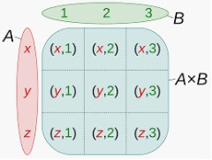
Cross Join / Cartesian Product
A cross join produces a result set that includes each row from the first table joined with each row from the second table.
The result set is known as the Cartesian product of the tables.
A cross join joins each row from the first table with each row from the second table. The result set returned by a cross join is known as a Cartesian product.
https://en.wikipedia.org/wiki/Cartesian_product

Slide 41
The explicit syntax for a cross join
SELECT select_list

FROM table_1 CROSS JOIN table_2
A cross join that uses the explicit syntax
SELECT departments.department_number, department_name,
employee_id, last_name
FROM departments CROSS JOIN employees ORDER BY departments.department_number
(45 rows)

Slide 42
The implicit syntax for a cross join
SELECT select_list FROM table_1, table_2

A cross join that uses the implicit syntax
SELECT departments.department_number, department_name,
employee_id, last_name
FROM departments, employees
ORDER BY departments.department_number
(45 rows)

Slide 43
Union
Like a join, a union combines data from
two or more tables.
Instead of combining columns from base tables, however, a union combines rows from two or more result sets
A union combines the result sets of two or more SELECT statements into one result set.
Each result set must return the same number of columns, and the corresponding columns in each result set must have compatible data types.
By default, a union eliminates duplicate rows. If you want to include duplicate rows, code the ALL keyword.
The column names in the final result set are taken from the first SELECT clause. Column aliases assigned by the other SELECT clauses have no effect on the final result set.
To sort the rows in the final result set, code an ORDER BY clause after the last SELECT statement. This clause must refer to the column names assigned in the first SELECT clause.

Slide 44
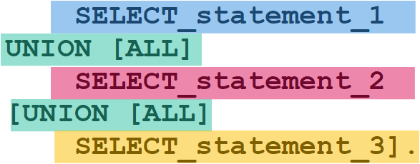
The syntax for a union operation
SELECT_statement_1 UNION [ALL]

SELECT_statement_2 [UNION [ALL]
SELECT_statement_3]...
[ORDER BY order_by_list]
Rules for a union
Each result set must return the same number of columns.
The corresponding columns in each result set must have compatible data types.
The column names in the final result set are taken from the first SELECT clause.

Slide 45
A union that combines result sets from two different tables

SELECT 'Active' AS source, invoice_number,
invoice_date, invoice_total
FROM active_invoices
WHERE invoice_date >= '2014-06-01'
UNION
SELECT 'Paid' AS source, invoice_number, invoice_date, invoice_total
FROM paid_invoices
WHERE invoice_date >= '2014-06-01'
ORDER BY invoice_total DESC

Slide 47
TRY IT YOURSELF
MYSQL - RETRIEVE DATA FROM MULTIPLE TABLES
Using the ap database, write a query to satisfy the following requirements:

Slide 48
TRY IT YOURSELF
MYSQL - RETRIEVE DATA FROM MULTIPLE TABLES
Using the ap database, write a query to satisfy the following requirements:

Slide 49
TRY IT YOURSELF
MYSQL - RETRIEVE DATA FROM MULTIPLE TABLES
Using the ap database, write a query to satisfy the following requirements:

Slide 50
TRY IT YOURSELF
MYSQL - RETRIEVE DATA FROM MULTIPLE TABLES
Using the ap database, write a query to satisfy the following requirements:

Slide 51
Terms to know
Join
Join condition
Inner join
Ad hoc relationship
Qualified column name
Table alias
Schema
Self-join
Explicit syntax (SQL-92)
Implicit syntax


Slide 52
Terms to know
Outer join
Left outer join
Right outer join
Equijoin
Natural join
Cross join
Cartesian product


Slide 53
Terms to know
Union
Full outer join


