Slide 1
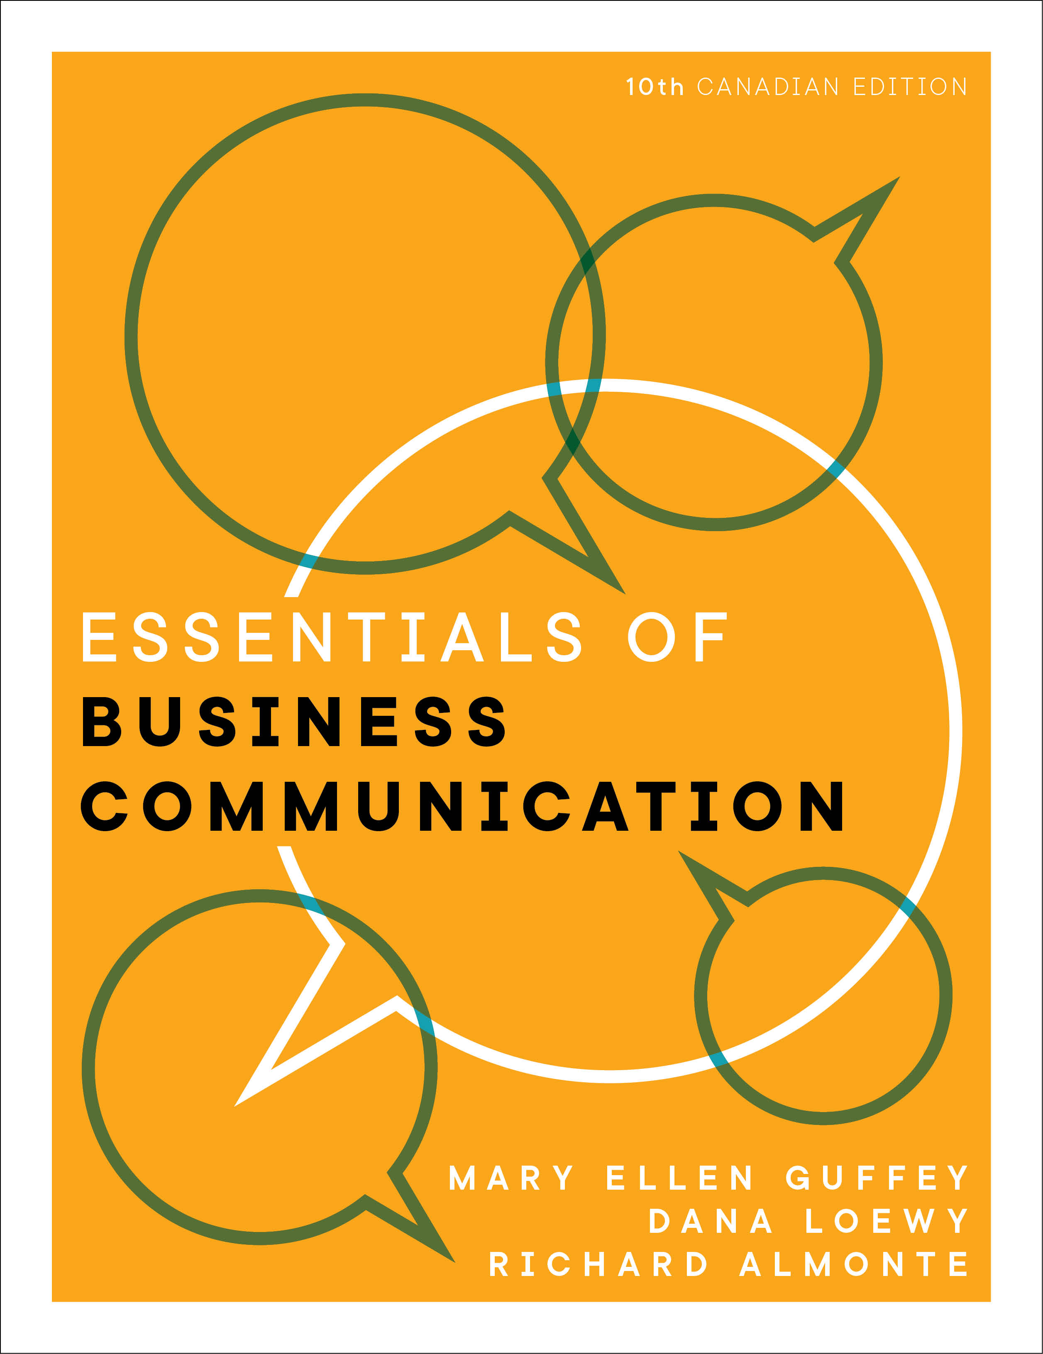

PowerPoint® Slides
to Accompany
Prepared by
Jennifer Powell,
Red River College

Slide 2
Chapter 12
The Job Search, Résumés, and Cover Letters

Slide 3
Objectives
12.1 Identify your employment interests and market requirements.
12.2 Use traditional and digital job-search techniques in the open and hidden markets.
12.3 Organize and format persuasive résumés.
12.4 Use social media, video, and infographic résumés as alternatives to traditional résumés.
12.5 Write a persuasive cover letter to accompany your résumé.

Slide 4
Preparing for Employment
Identify your interests.
  Analyze what you like and dislike.
Assess your qualifications.
  Analyze your assets.
Explore career opportunities.
  Campus career centre, Internet, summer job, volunteer
Notes:
Think-Pair-Share: Go through the questions on page 339 and discuss.

Slide 5
Searching for Jobs in the Open and Hidden Markets
Use “open market” sites.
Go beyond the big sites.
Use LinkedIn and other social networking sites.
Network to find “hidden market” opportunities.
Build a personal brand.

Slide 6
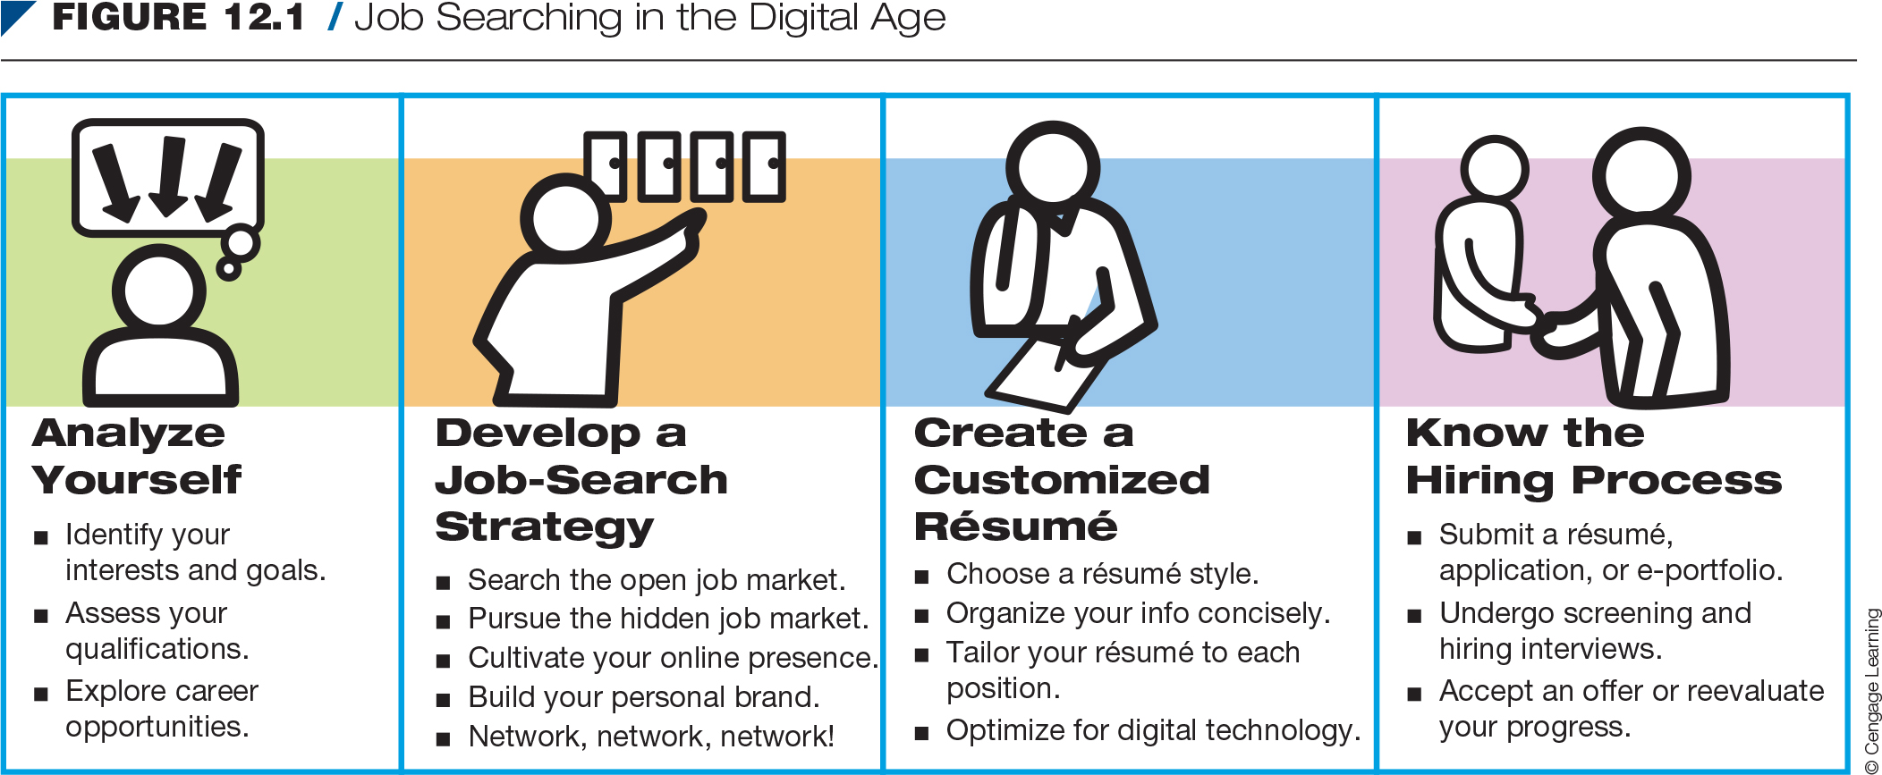
Job Searching in the Digital Age

Slide 7
Choose a Résumé Style
  Chronological
    Most popular
    Lists work history job by job, starting with most recent position
    Recruiters prefer this type of résumé
Notes:
Look at the example of a chronological résumé in Figure 12.6 on page 347.

Slide 8
Choose a Résumé Style (cont’d)
Functional
  Focuses attention on candidate’s skills rather than past employment
  Includes a short employment section
Notes:
Look at the example of a functional résumé in Figure 12.7 on page 348.

Slide 9
Decide on Length
  Two-pages is preferred.
Notes:
Studies with recruiters revealed that while they said they preferred one-page résumés, they actually chose to interview the applicants with two-page résumés.

Slide 10
Organize Your Information
Under Headings
Main heading
  Name, contact information, LinkedIn page or video site
Career objective
  Focus on employer’s needs

Slide 11
Organize Your Information
Under Headings (cont’d)
Summary of qualifications
  Three to eight bulleted statements that prove you are the ideal candidate
Education
  Include name and location of schools, dates of attendance, major fields of study, and certifications

Slide 12
Organize Your Information
Under Headings (cont’d)
Work experience or employment history
  List the most recent employment first and work backward.
  Include only those jobs that will help win the targeted position.
  Describe employment achievements concisely but concretely.

Slide 13
Organize Your Information
Under Headings (cont’d)
Capabilities and skills
  Emphasize the skills and aptitudes that prove you are qualified for a specific position.
  Highlight exceptional aptitudes and evidence to back up your assertions.

Slide 14
Organize Your Information
Under Headings (cont’d)
    Awards, honours, and activities
      Highlight them by listing under a separate heading.
      Personal data
        Omit birthdate, marital status, or national origin.
      References
        Bring a list to the interview.
        Do not include personal references.
Notes:
Do not include References available upon request. It is unnecessary and takes up space.

Slide 15
Online Résumé Reading Patterns
    People read text-based pages online in an F-shaped pattern
    Online résumés are read horizontally on the top third of the page, and then on the left side as they read downward.

Slide 16
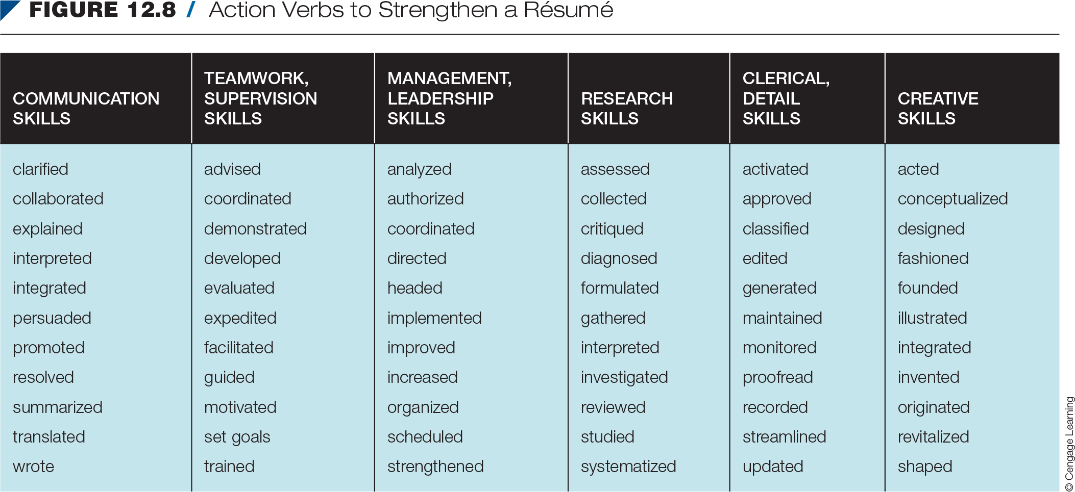
Action Verbs to Strengthen a Résumé

Slide 17
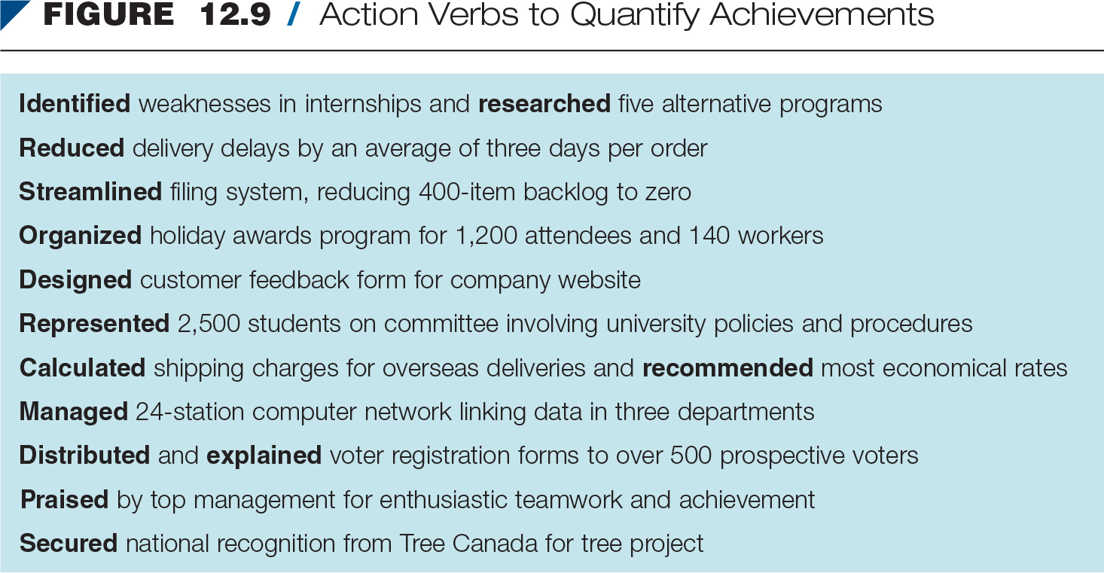
Action Verbs to Quantify Achievements
Notes:
Discuss Figures 12.8 and 12.9 from page 352. Have students discuss examples that might apply to their own résumés.

Slide 18
Polish Your Résumé and
Keep It Honest
    Consolidate and condense headings.
    Improve readability through the use of capitalizing, underlining, indenting, and bulleting.
    Be honest and avoid distorting facts.

Slide 19
Proofread Your Résumé
    Proofread multiple times for spelling, grammar, mechanics, content, and format.
    One typo could eliminate you from consideration.
    Be prepared to write (and rewrite) your résumé yourself.

Slide 20
Increasing Your Chances With
Digital Tools
Get your résumé selected: maximize keyword hits.
  Include specific keywords or keyword phrases.
  Focus on nouns.
  Use variations of the job title.
  Concentrate on the skills section.
  Skip a keyword summary.
Expand your résumé’s appeal: add video.

Slide 21
Increasing Your Chances With
Digital Tools (cont’d)
Translate into pictures: the infographic résumé
  Use colourful charts, graphics, and timelines

Slide 22
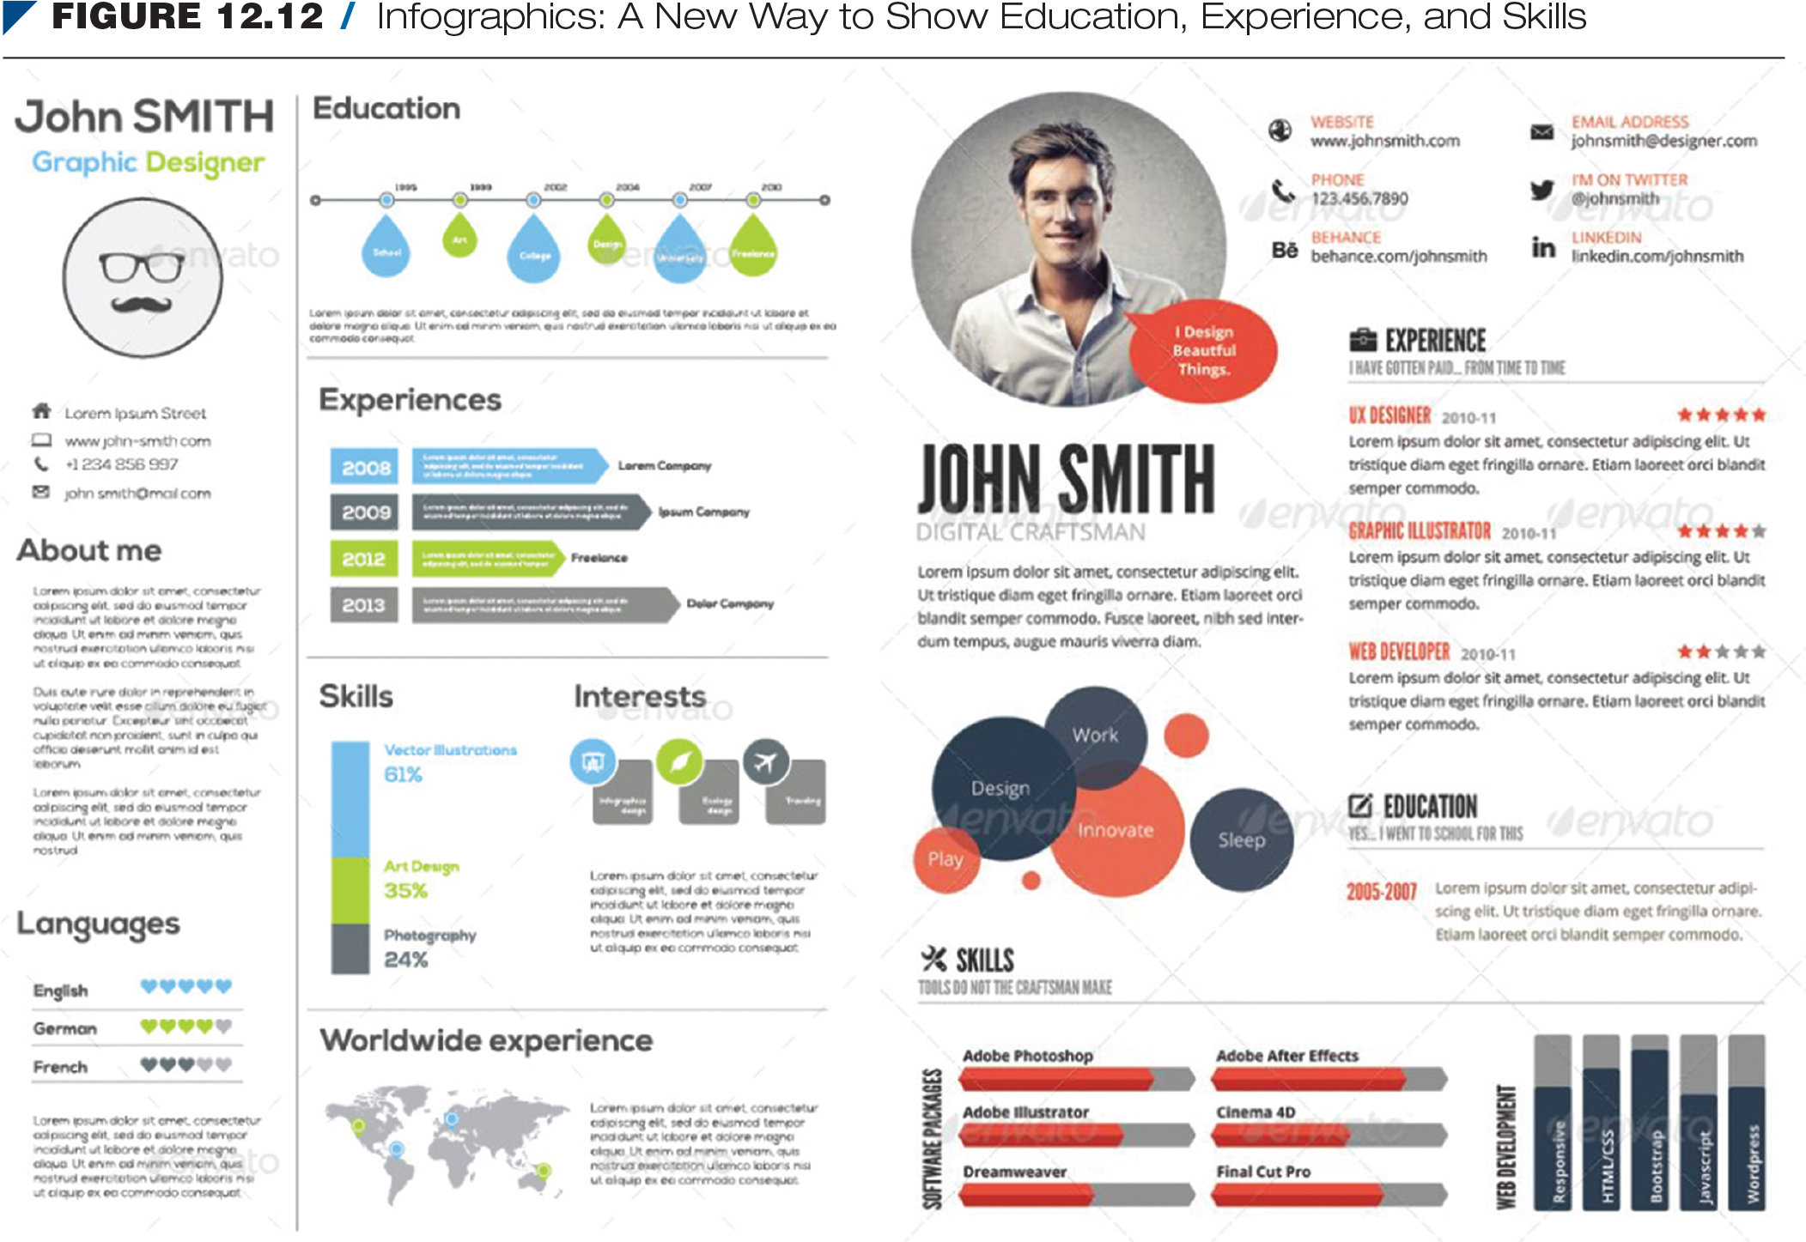
Infographics: A New Way to Show Education, Experience, and Skills

Slide 23
Increasing Your Chances With
Digital Tools (cont’d)
Submitting your résumé
  Word document
  PDF
  Company database
  Fax or in person
Notes:
Send or post your résumé in the format the employer requests.

Slide 24
Persuasive Cover Letters
Gain attention in the opening.
  Address the reader by name.
  Consider differences in cover letters for solicited and unsolicited jobs.
Notes:
Look at examples of solicited and unsolicited cover letters in Figures 12.13 and 12.14 on pages 360 and 361.

Slide 25
Persuasive Cover Letters (cont’d)
Build interest in the body.
  Relate your letter to a specific position.
  Emphasize reader benefits.
  Discuss your strongest qualifications and relevant personal traits.
Notes:
Look at examples of solicited and unsolicited cover letters in Figures 12.13 and 12.14 on pages 360 and 361.

Slide 26
Persuasive Cover Letters (cont’d)
Motivate action in the closing.
  Ask for an interview.
Avoid I dominance.
Send your cover letter by email.
Notes:
Look at examples of solicited and unsolicited cover letters in Figures 12.13 and 12.14 on pages 360 and 361.

Slide 27
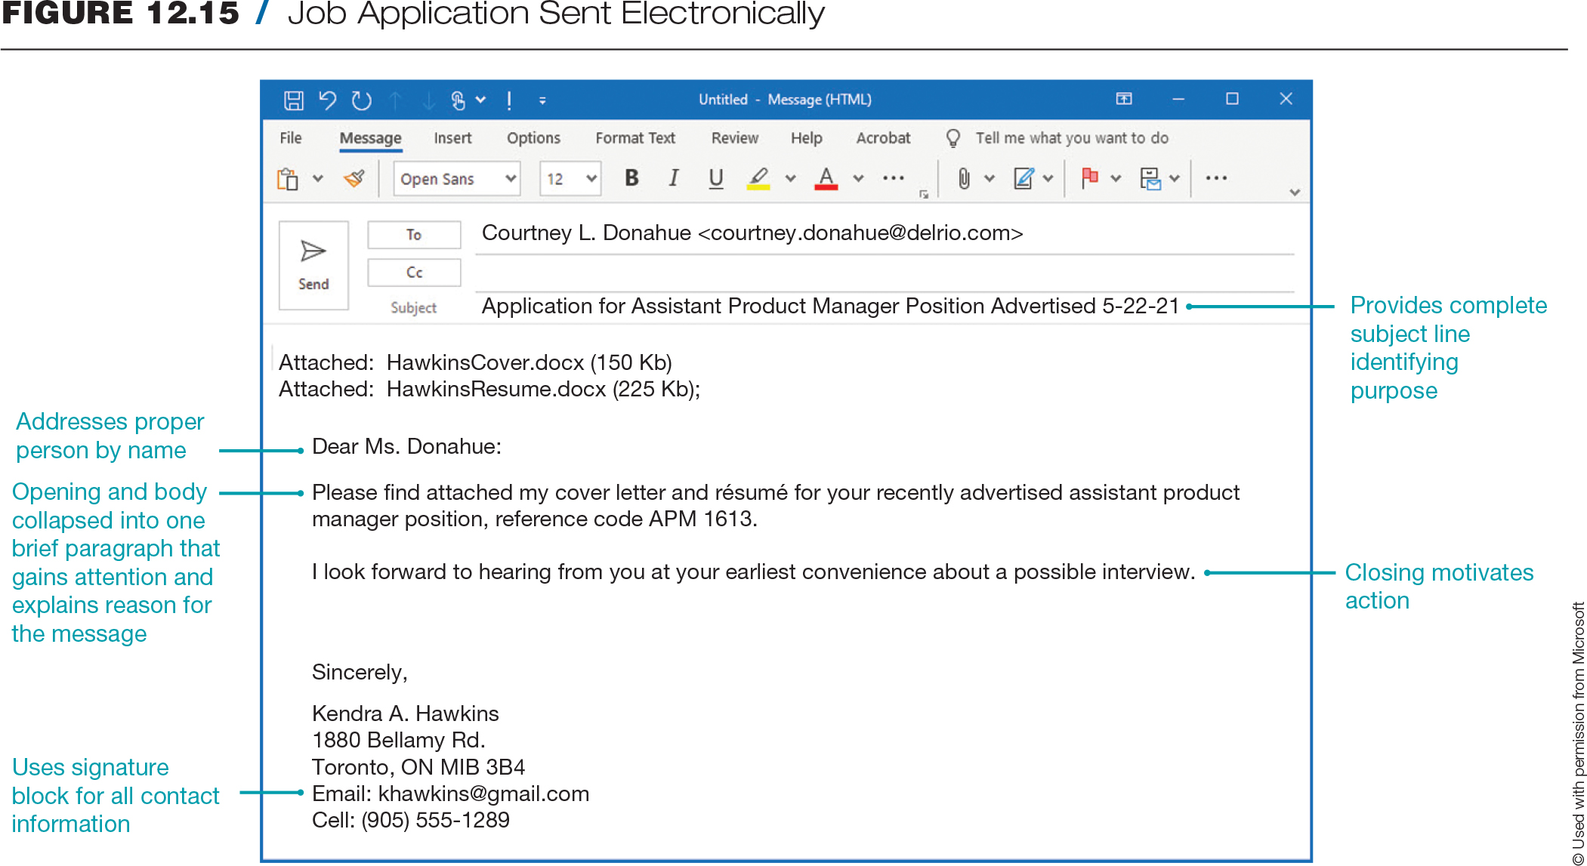
Job Application Sent Electronically

Slide 28
Summary
Identify your employment interests and market requirements.
Use traditional and digital job-search techniques in the open and hidden markets.
Organize and format persuasive résumés.
Use social media, video, and infographic résumés as alternatives to traditional résumés.
Write a persuasive cover letter to accompany your résumé.

Slide 29
Chapter 13
Interviews and Follow-Up

Slide 30
Objectives
13.1 Explain the purposes and types of job interviews.
13.2 Know what to do before an interview to make an impressive initial contact.
13.3 Know what to do during an interview to create a favourable impression.
13.4 Know what to do immediately after an interview to maintain the positive impression you’ve created.
13.5 Prepare useful employment-related documents.

Slide 31
Types of Employment Interviews
Screening interviews
Hiring/placement interviews
One-on-one interviews
Panel interviews
Group interviews
Notes:
Discuss each type of interview. Ask students about their experiences with the types of interviews.

Slide 32
Types of Employment Interviews (cont’d)
Sequential interviews
Stress interviews
Online, video, and virtual interviews

Slide 33
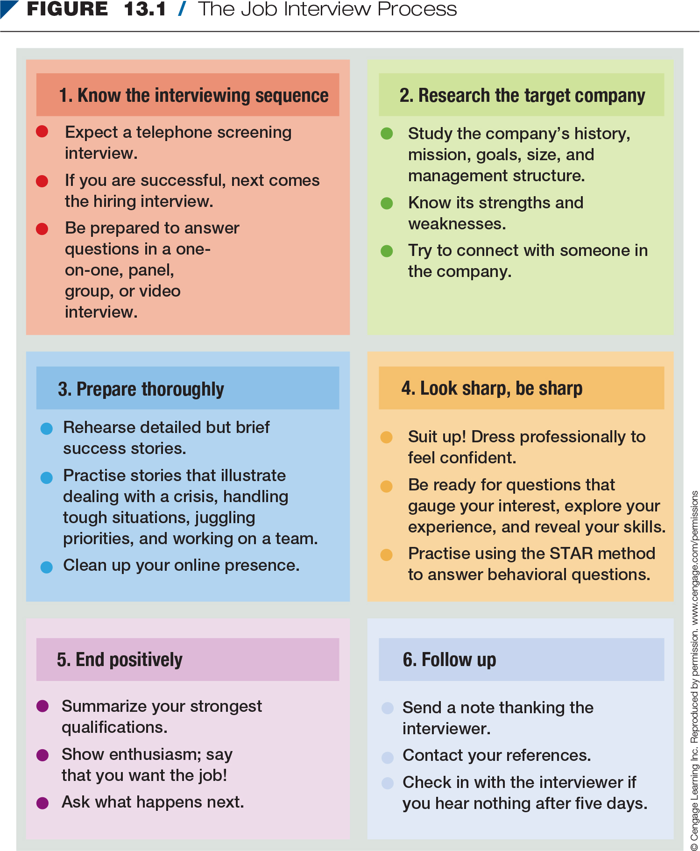
The Job Interview Process

Slide 34
Before the Interview
Use professional phone techniques.
Make the first conversation impressive.
Research the target company.
Notes:
Employers use screening interviews to narrow a list of candidates. If you do well in the screening interview, you will be invited for a more formal interview.

Slide 35
Prepare and Practise
  Rehearse success stories.
  Practise answers to possible questions.
  Clean up digital dirt.
  Expect to explain problem areas on your résumé.
  Decide how to dress.
  Gather items to bring.
Notes:
Practise success stories that emphasize your skills and accomplishments. Have students pair up and discuss their top five skills.

Slide 36
Get to Your Interview
  Give yourself time to groom, dress, and get to your interview.
  Be courteous to everyone.
  Don’t smoke or eat anything messy or smelly.
  Greet the interviewer confidently.
Notes:
Discuss the idea of visiting the physical building before the interview so that you know where to go.

Slide 37
Fight Fear
  Practise interviewing.
  Prepare thoroughly.
  Understand the process.
  Dress professionally.
  Breathe deeply.
  Know that you are not alone.
  Remember that an interview is a two-way street.
Notes:
Have the students pair up and practise interviewing.

Slide 38
Send Positive Nonverbal Messages and Act Professionally
Control body movements.
Exhibit good posture.
Practise appropriate eye contact.
Use gestures effectively.
Smile to convey a positive attitude.
Notes:
Remember that employers want to hire people who have confidence in their own abilities. Let your nonverbal messages show that you are secure.

Slide 39
Send Positive Nonverbal Messages and Act Professionally (cont’d)
Listen attentively.
Turn off devices.
Don’t chew gum.
Sound enthusiastic and interested—but sincere.
Avoid “empty” words.

Slide 40
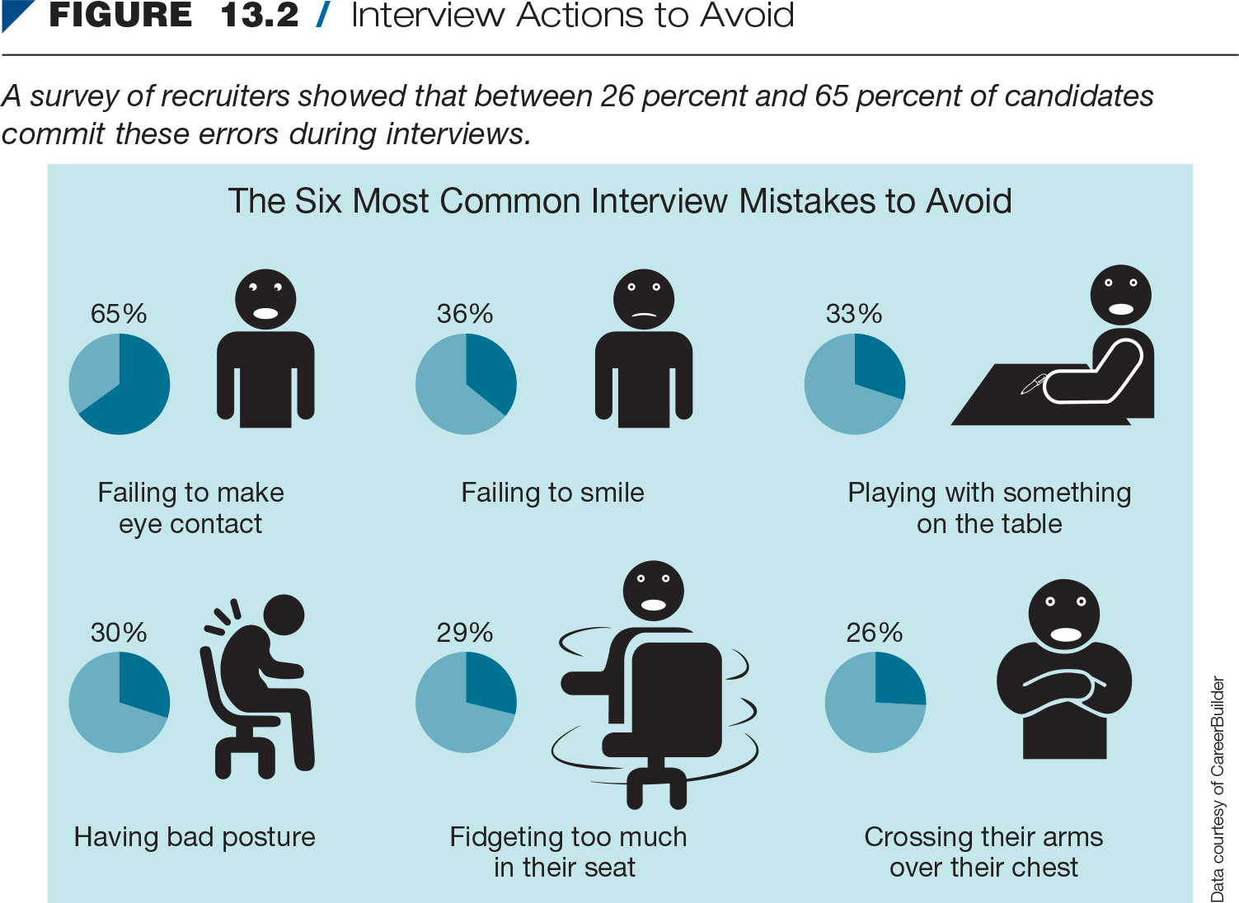
Interview Actions to Avoid

Slide 41
Answer Typical Questions Confidently
Questions to get acquainted
Questions to gauge your interest
Questions about your experience and accomplishments
Questions about the future
Challenging questions
Notes:
Go through the typical questions on pages 382 to 386. Have the students try mock interviews.

Slide 42
Answer Typical Questions Confidently (cont’d)
Situational questions
Behavioural questions
Illegal and inappropriate questions
Notes:
Discuss the STAR technique for answering behavioural interview questions.

Slide 43
During the Interview
Ask your own questions.
End positively.
Notes:
Discuss questions to ask interviewers on pages 386 and 387.

Slide 44
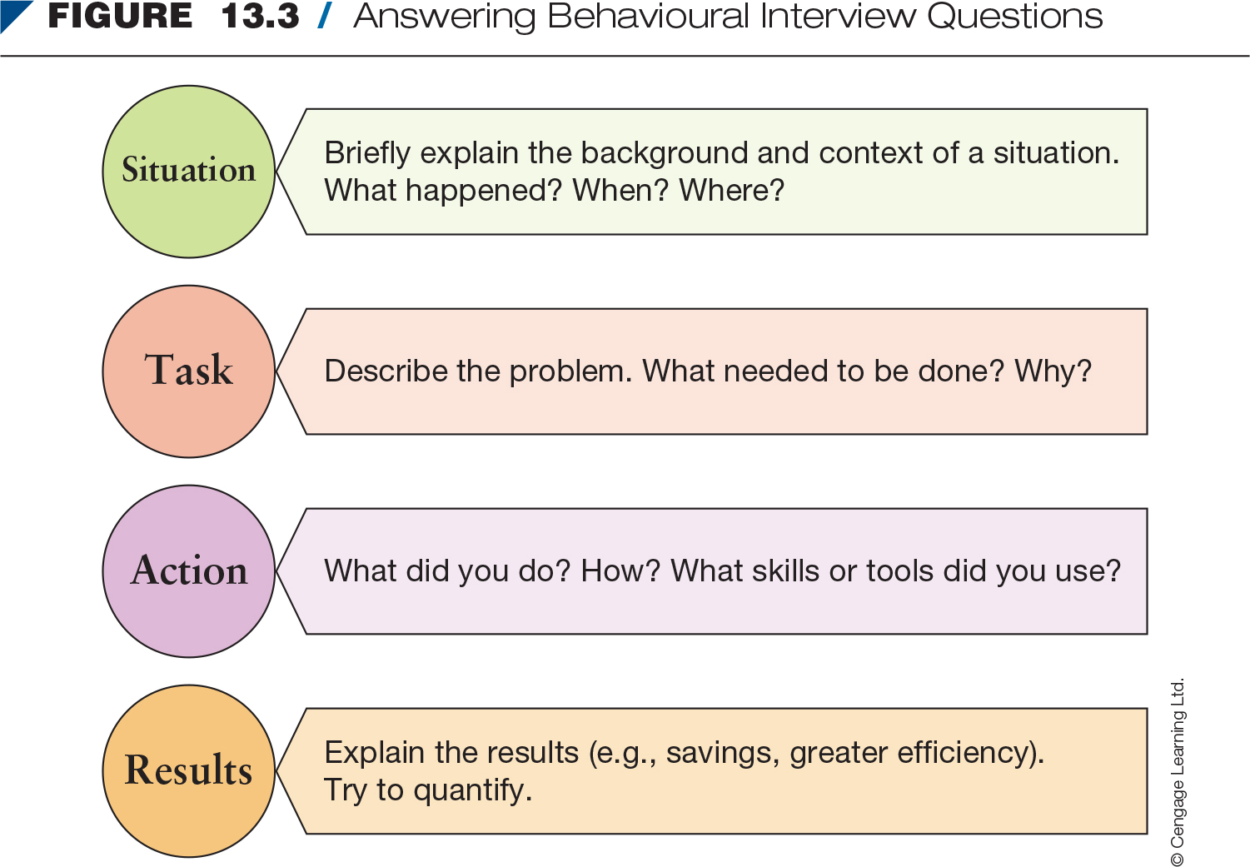
Answering Behavioural
Interview Questions

Slide 45
After the Interview
Thank your interviewer.
Contact your references.
Follow up.

Slide 46
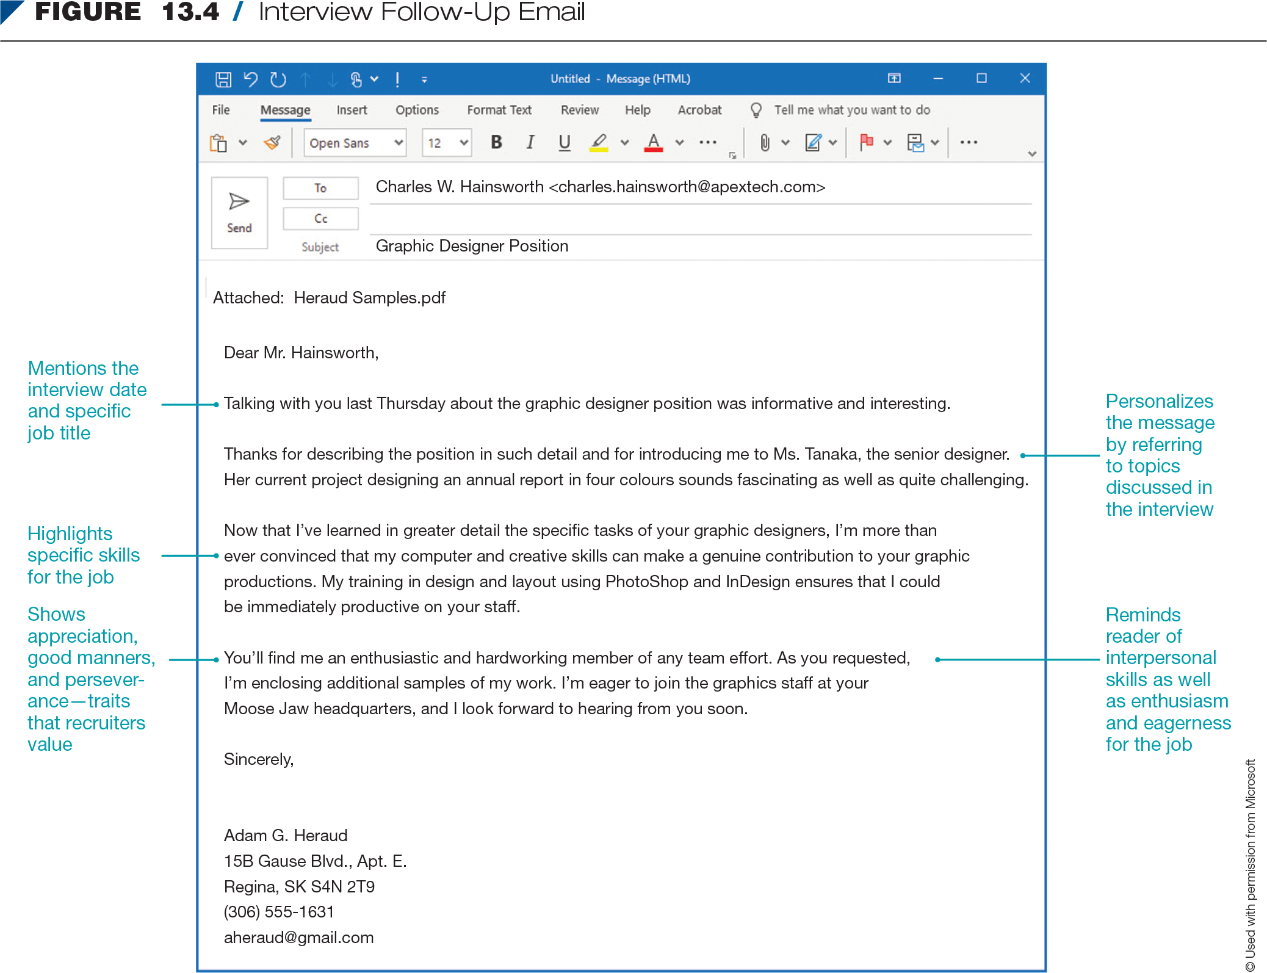
Interview Follow-Up Email

Slide 47
Other Employment Documents
Application form
Application or résumé follow-up message
Rejection follow-up message
Job acceptance and rejection messages
Resignation letter
Notes:
The authors discuss each document in detail on pages 390 to 392. Ask students about their experiences with each document.

Slide 48
Summary
Explain the purposes and types of job interviews.
Know what to do before an interview to make an impressive initial contact.
Know what to do during an interview to create a favourable impression.
Know what to do immediately after an interview to maintain the positive impression you’ve created.
Prepare useful employment-related documents.

